Slide 1
SD-IAP No.478
Marián Švajdler
UNLP Košice

Slide 2
Clinical history
86-year old men
Tumor of the scalp - biopsy

Slide 3
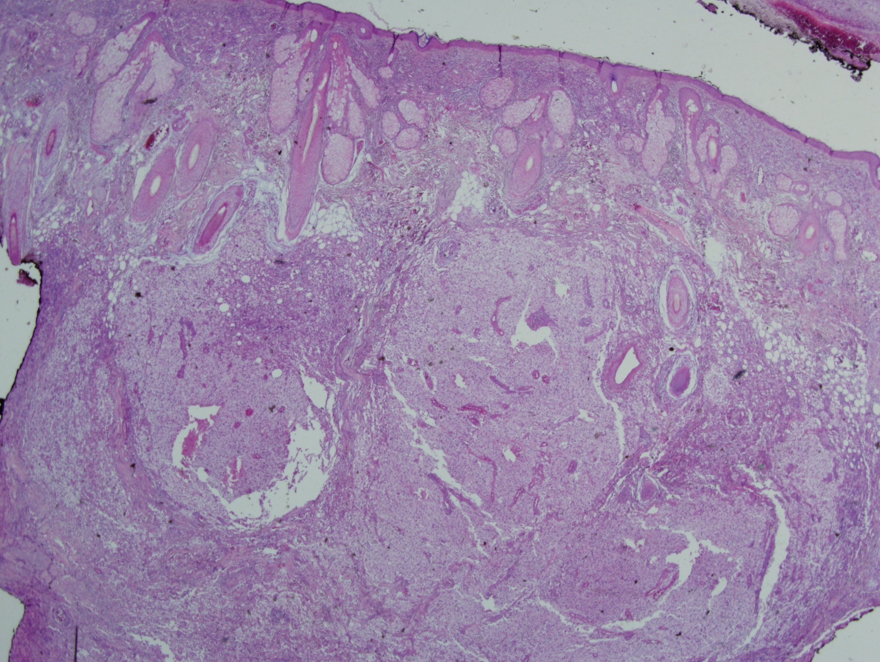

Slide 4
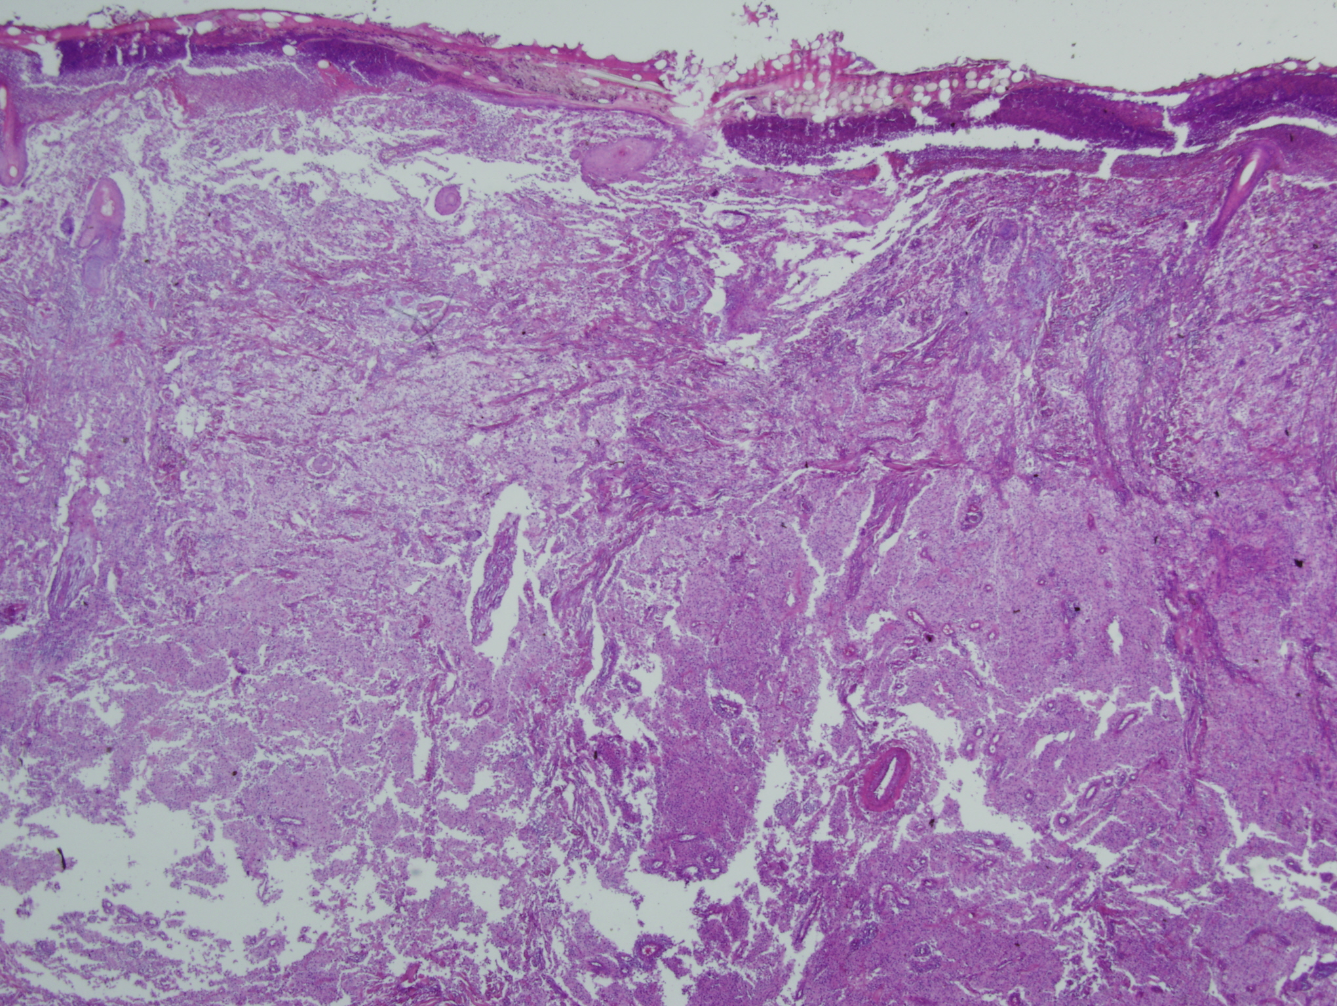

Slide 5
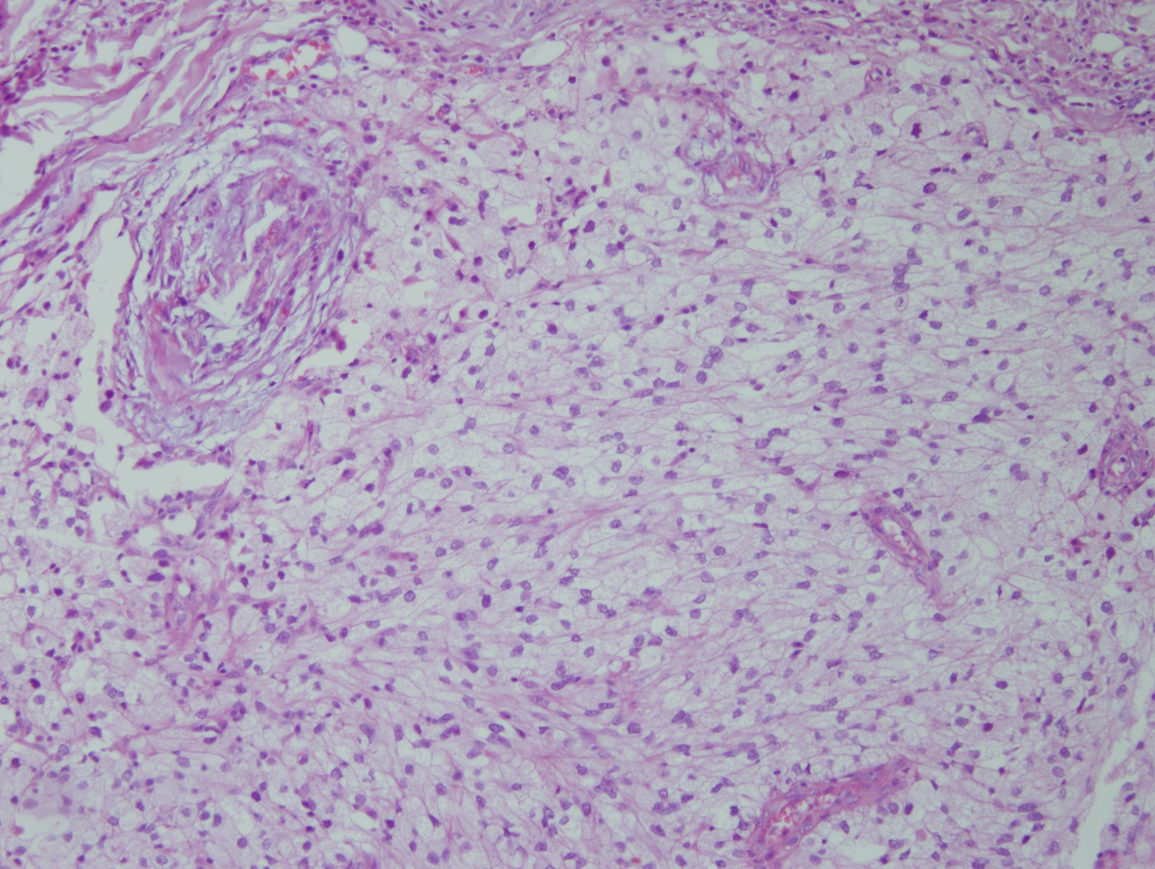

Slide 6
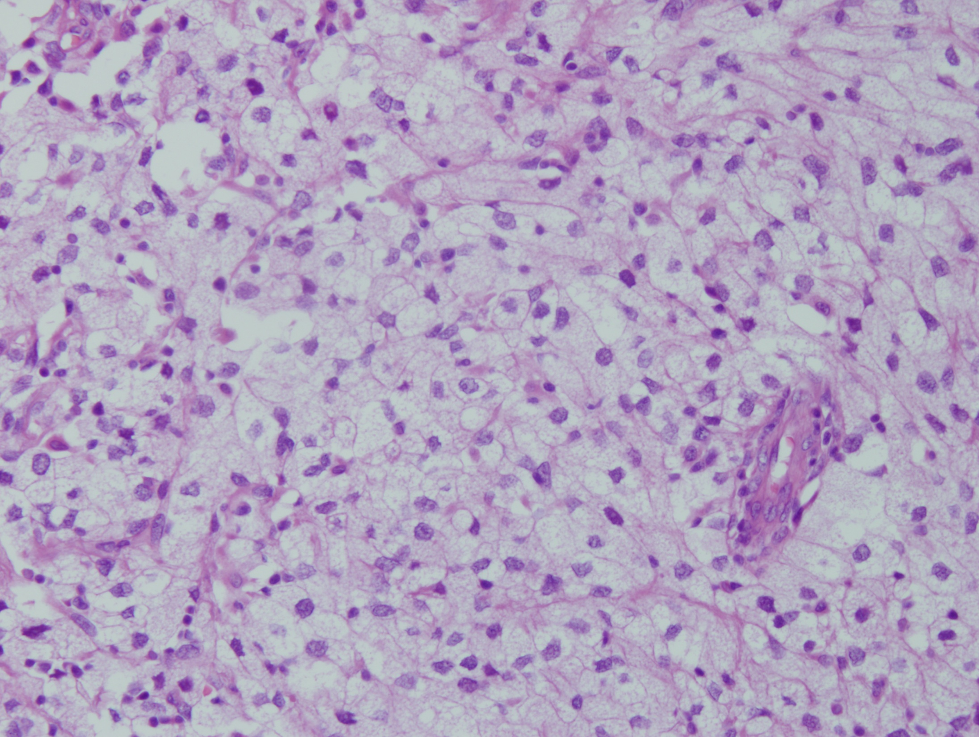

Slide 7
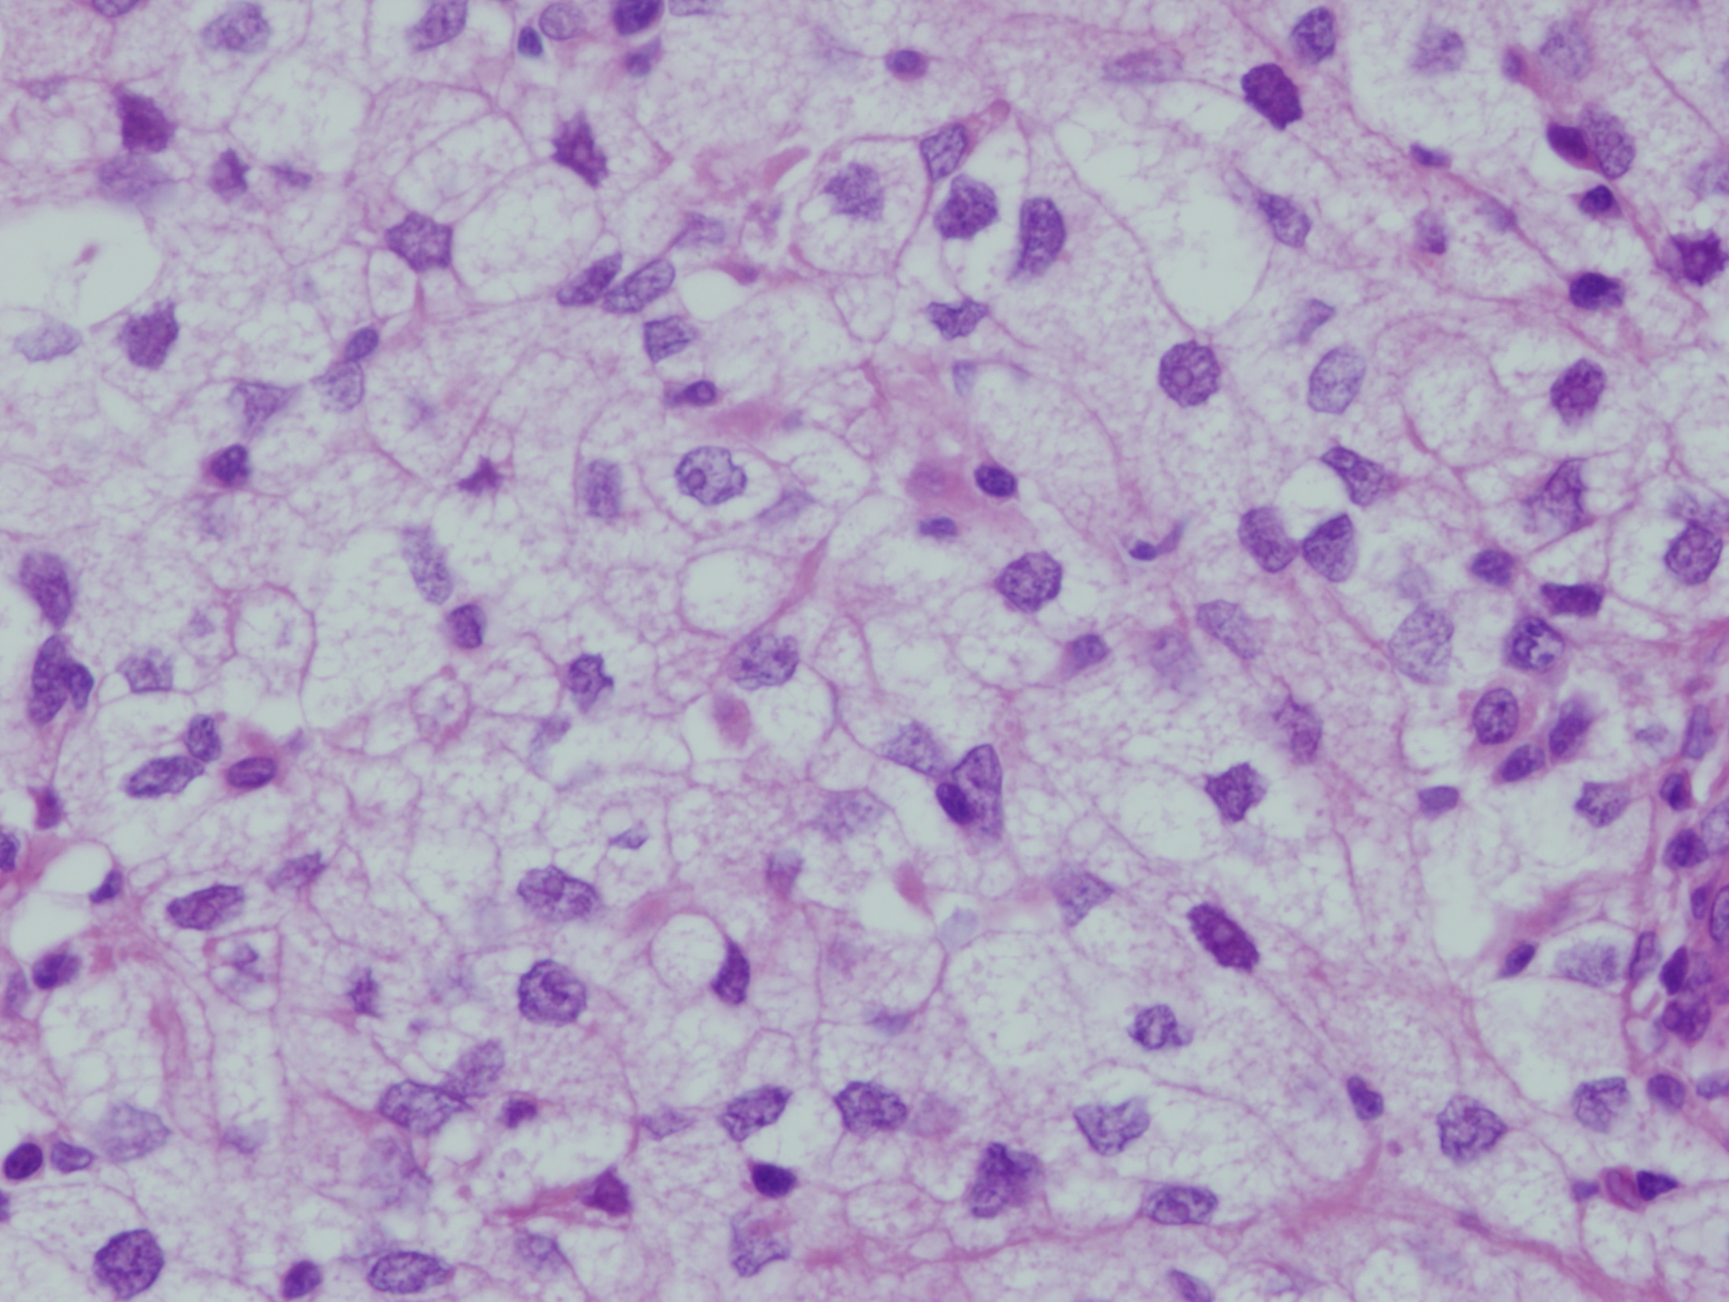

Slide 8
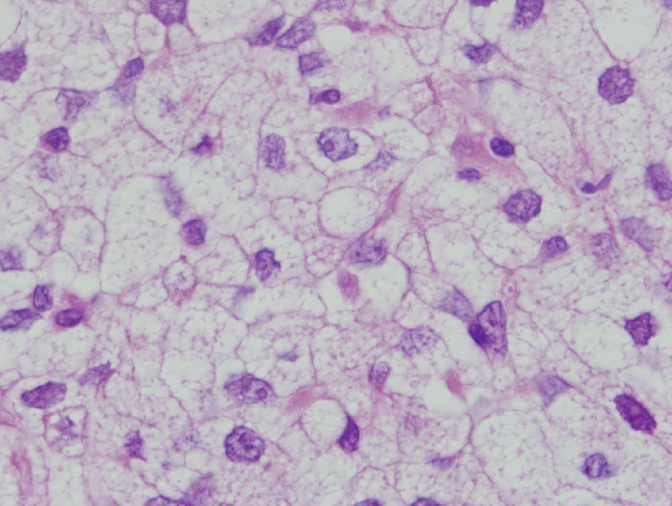

Slide 9
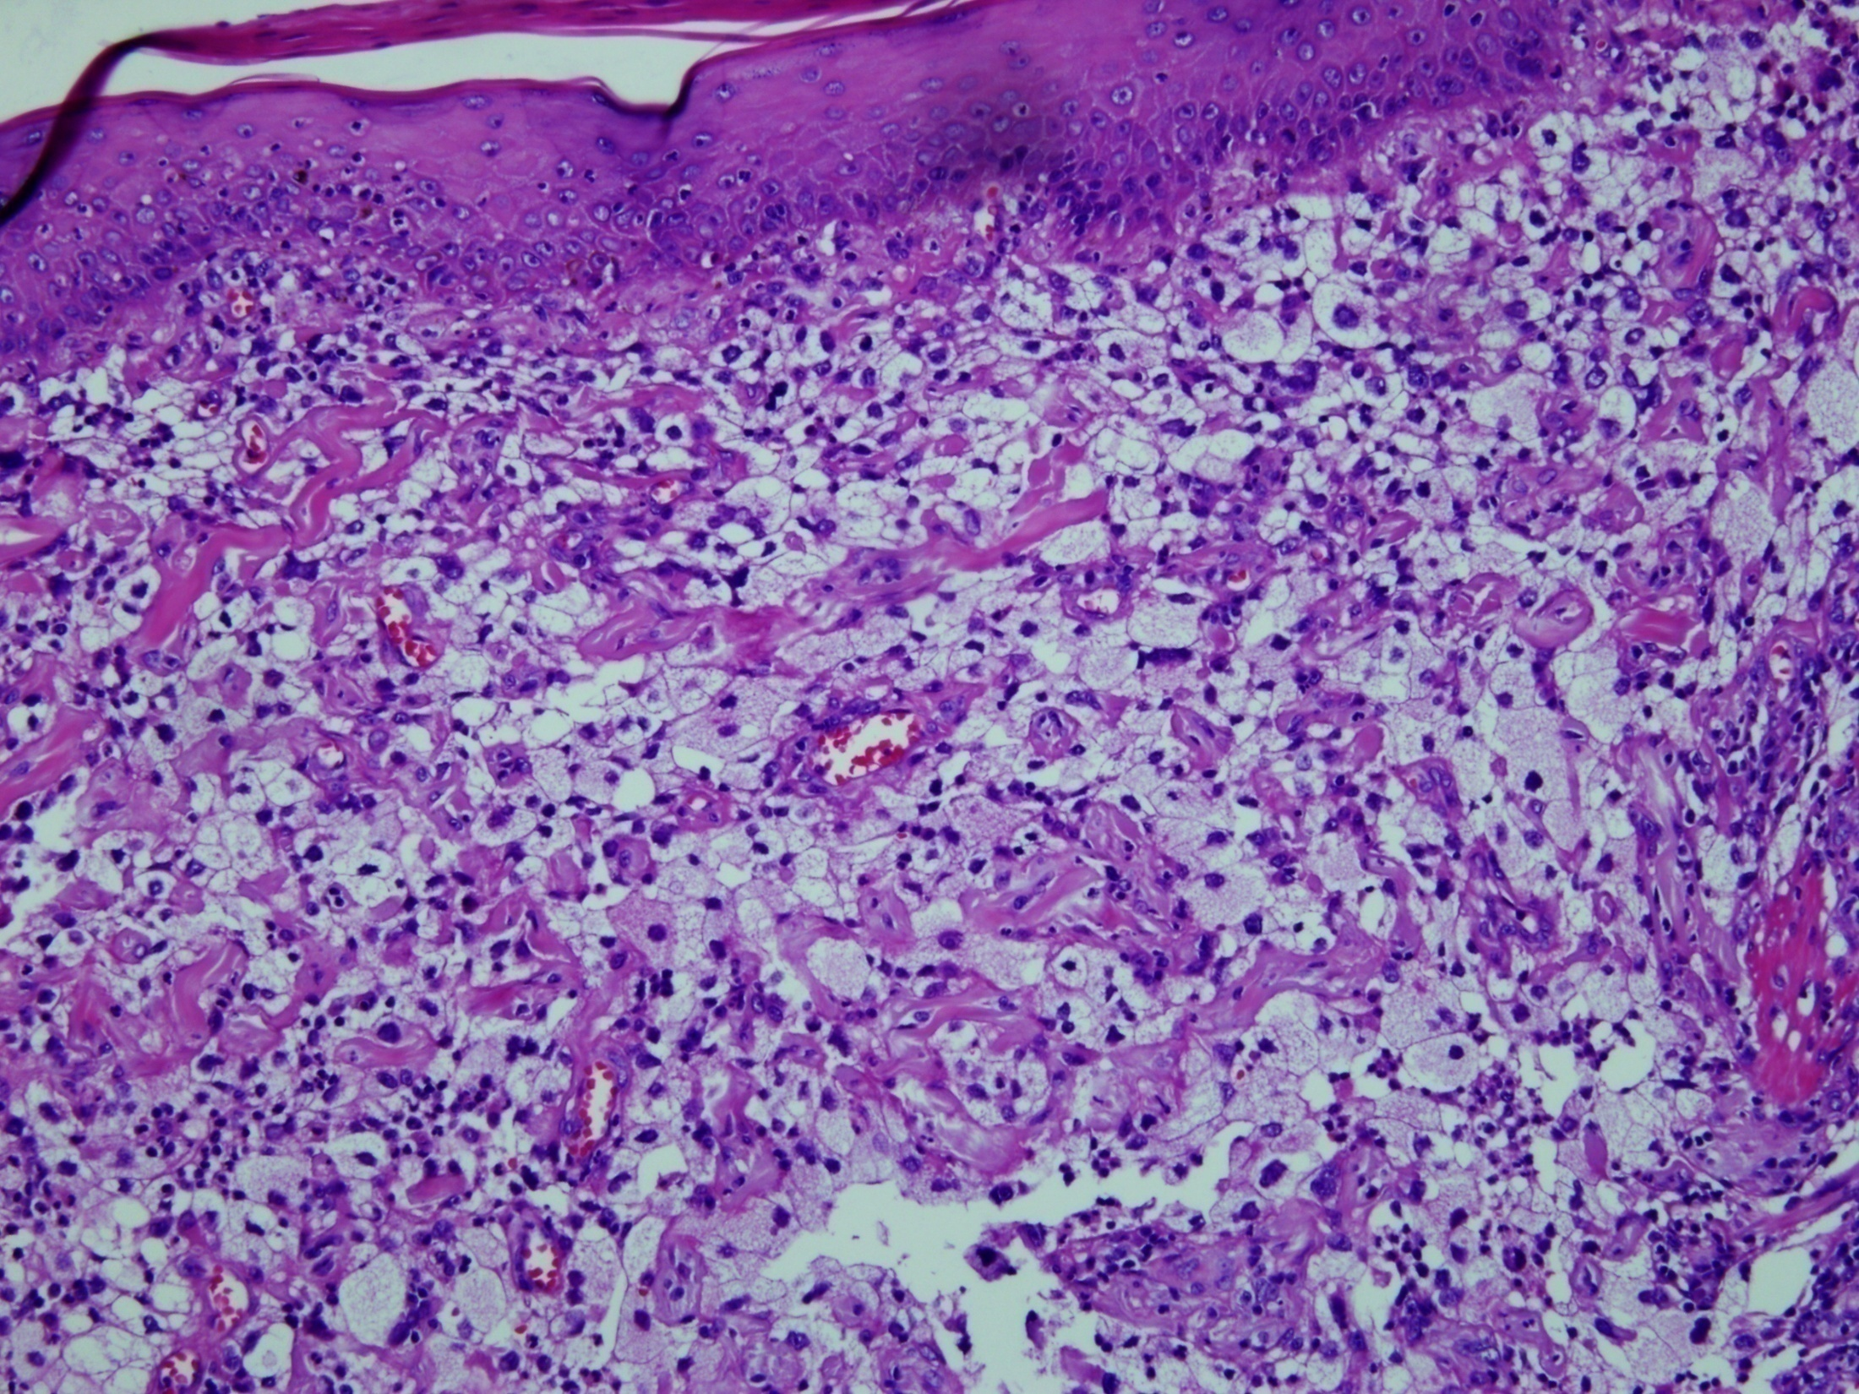

Slide 10
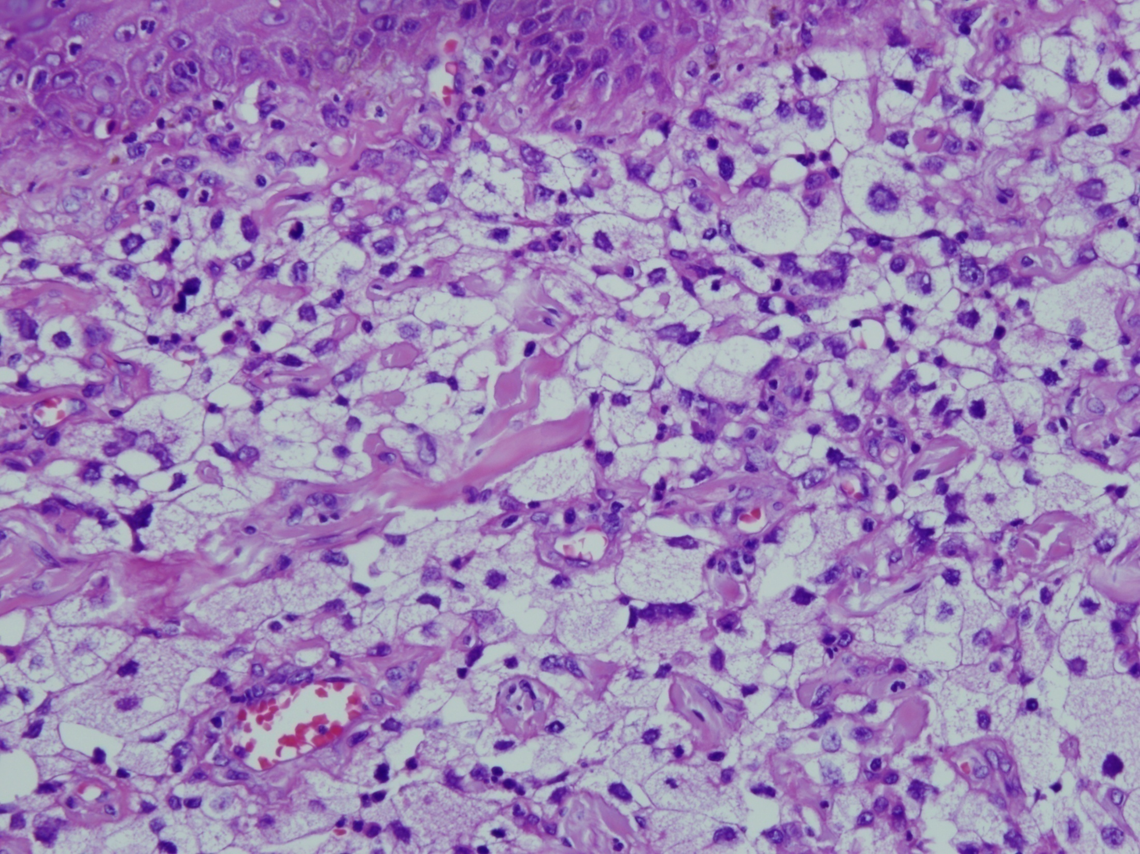

Slide 11
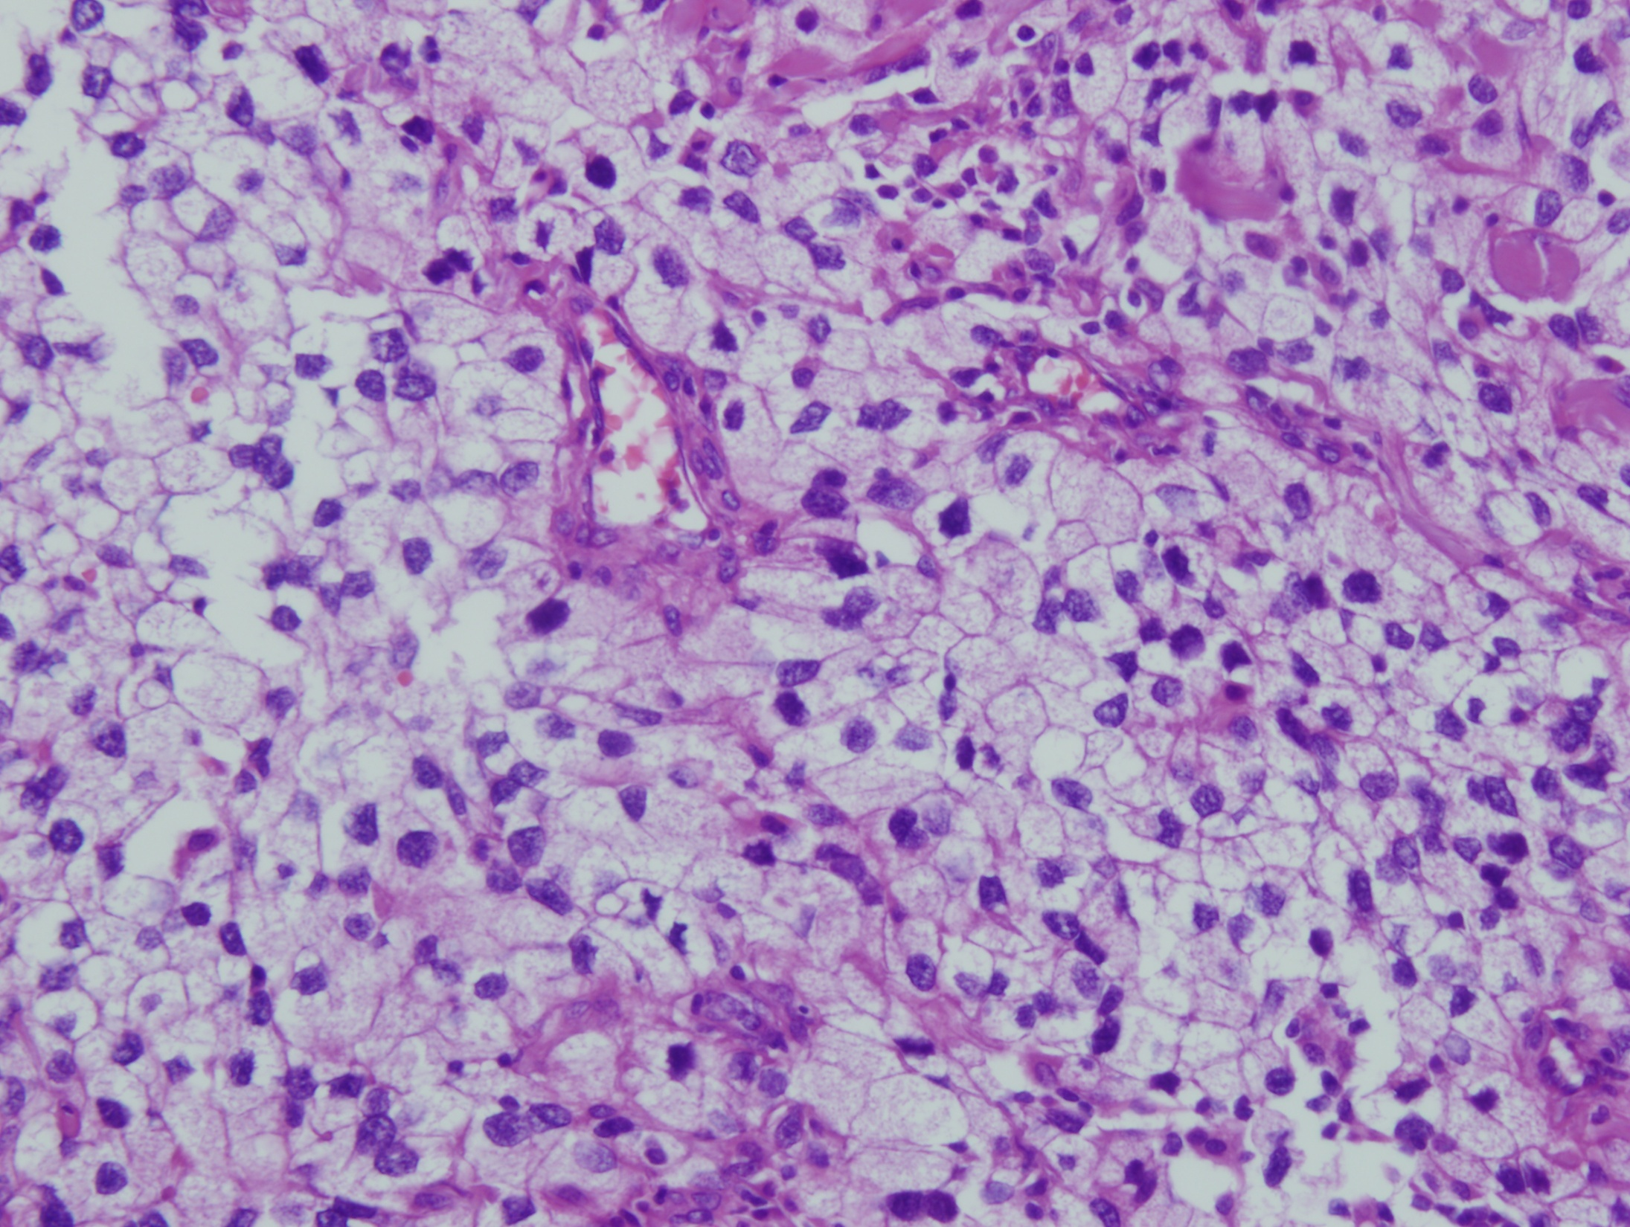

Slide 12
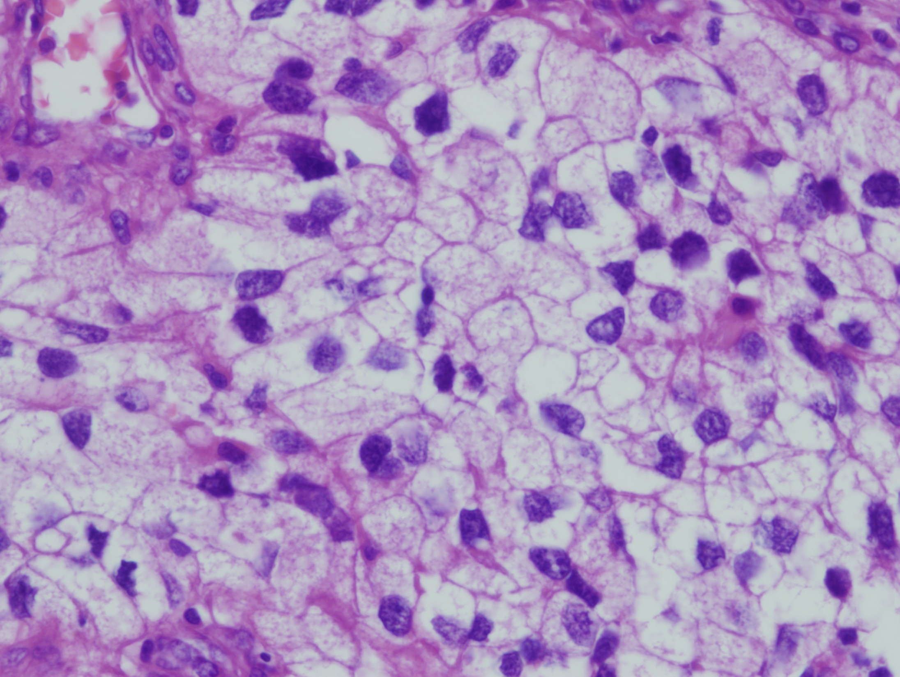

Slide 13
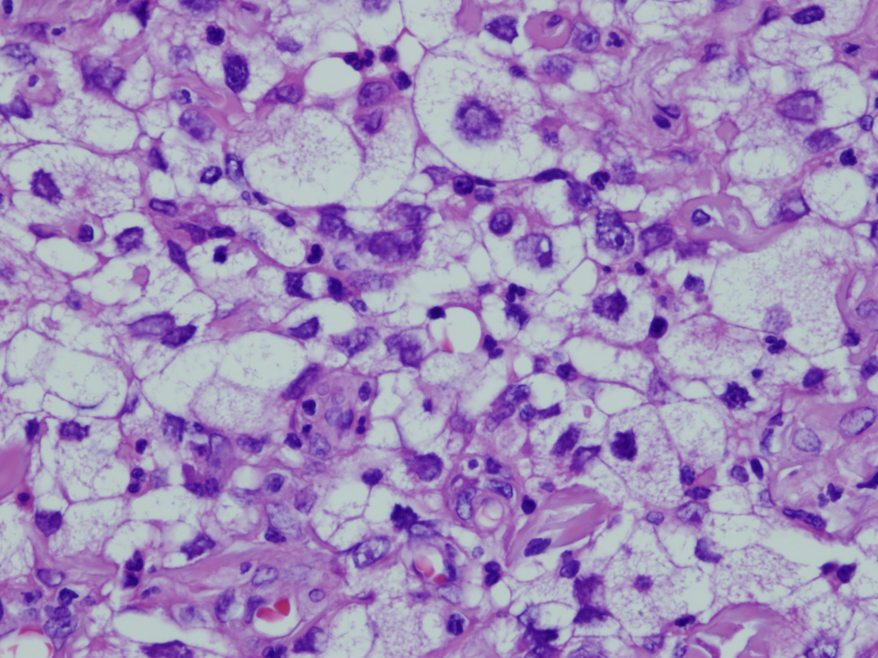

Slide 14
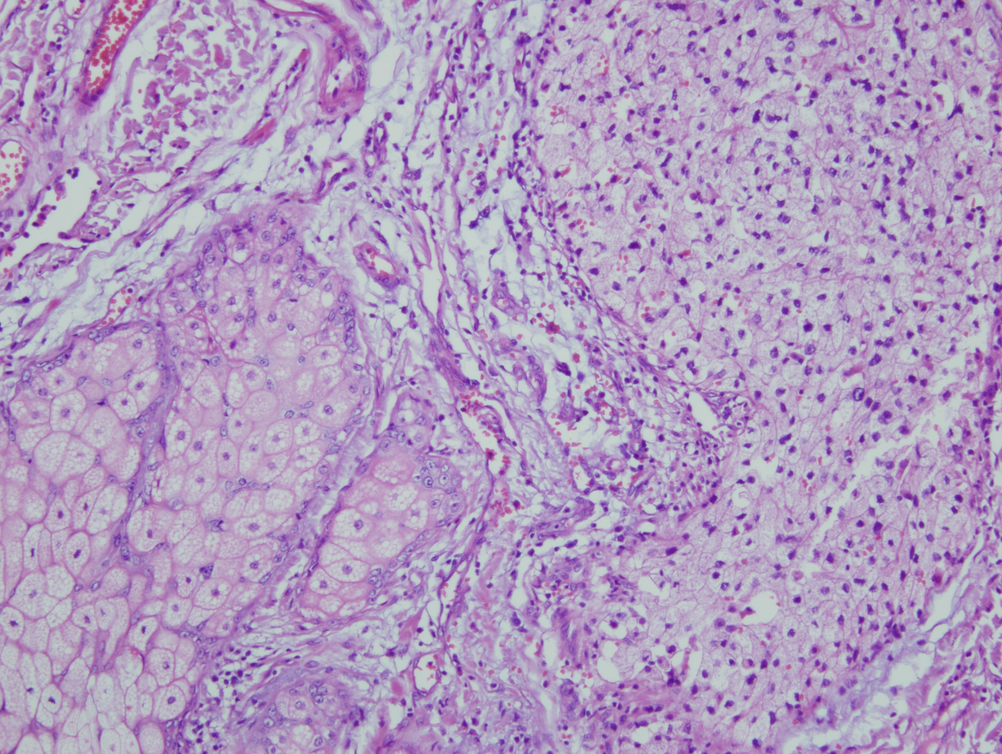

Slide 16
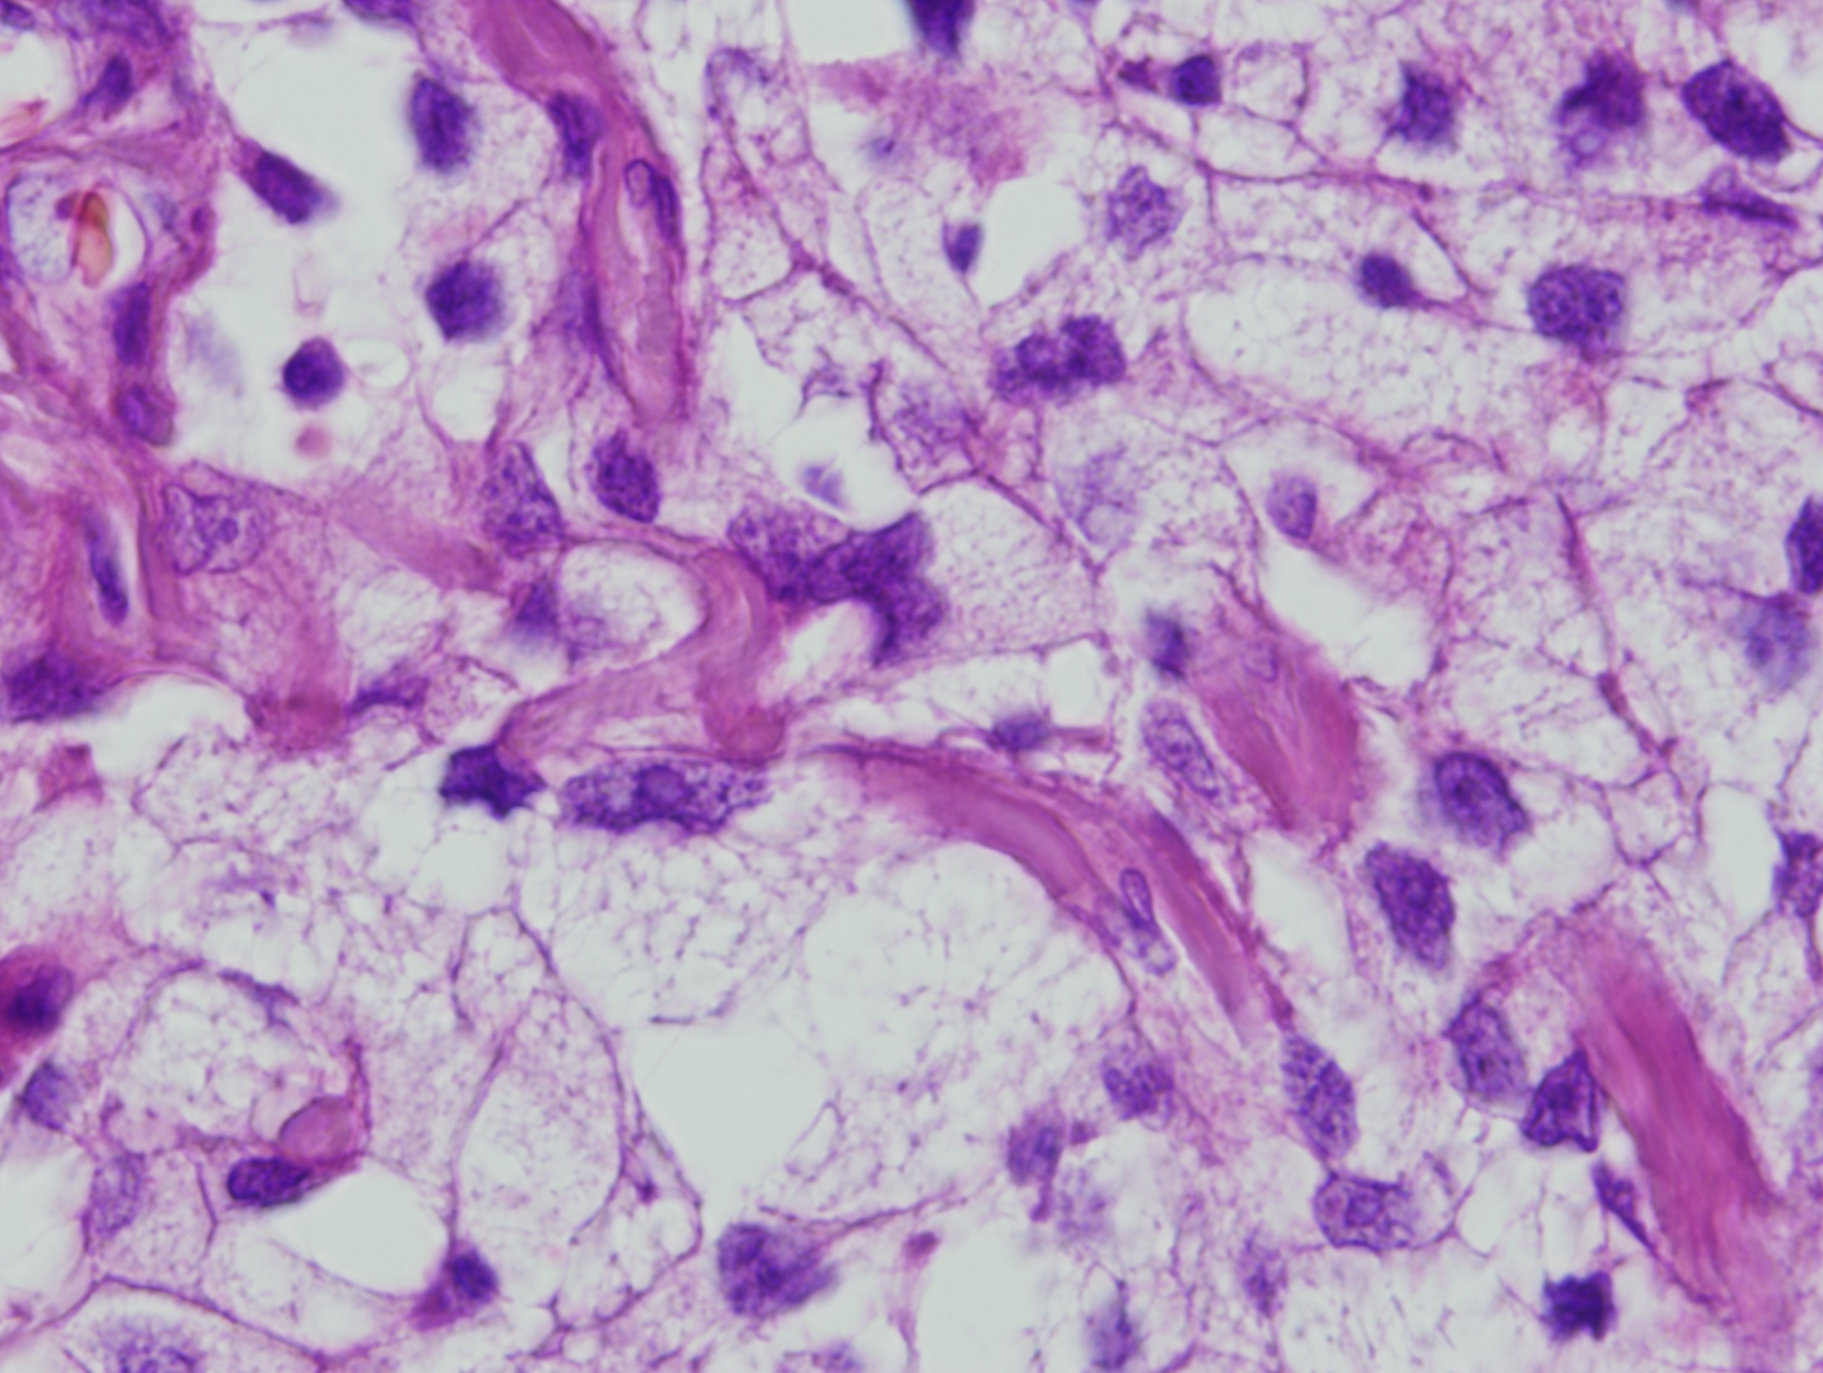

Slide 17
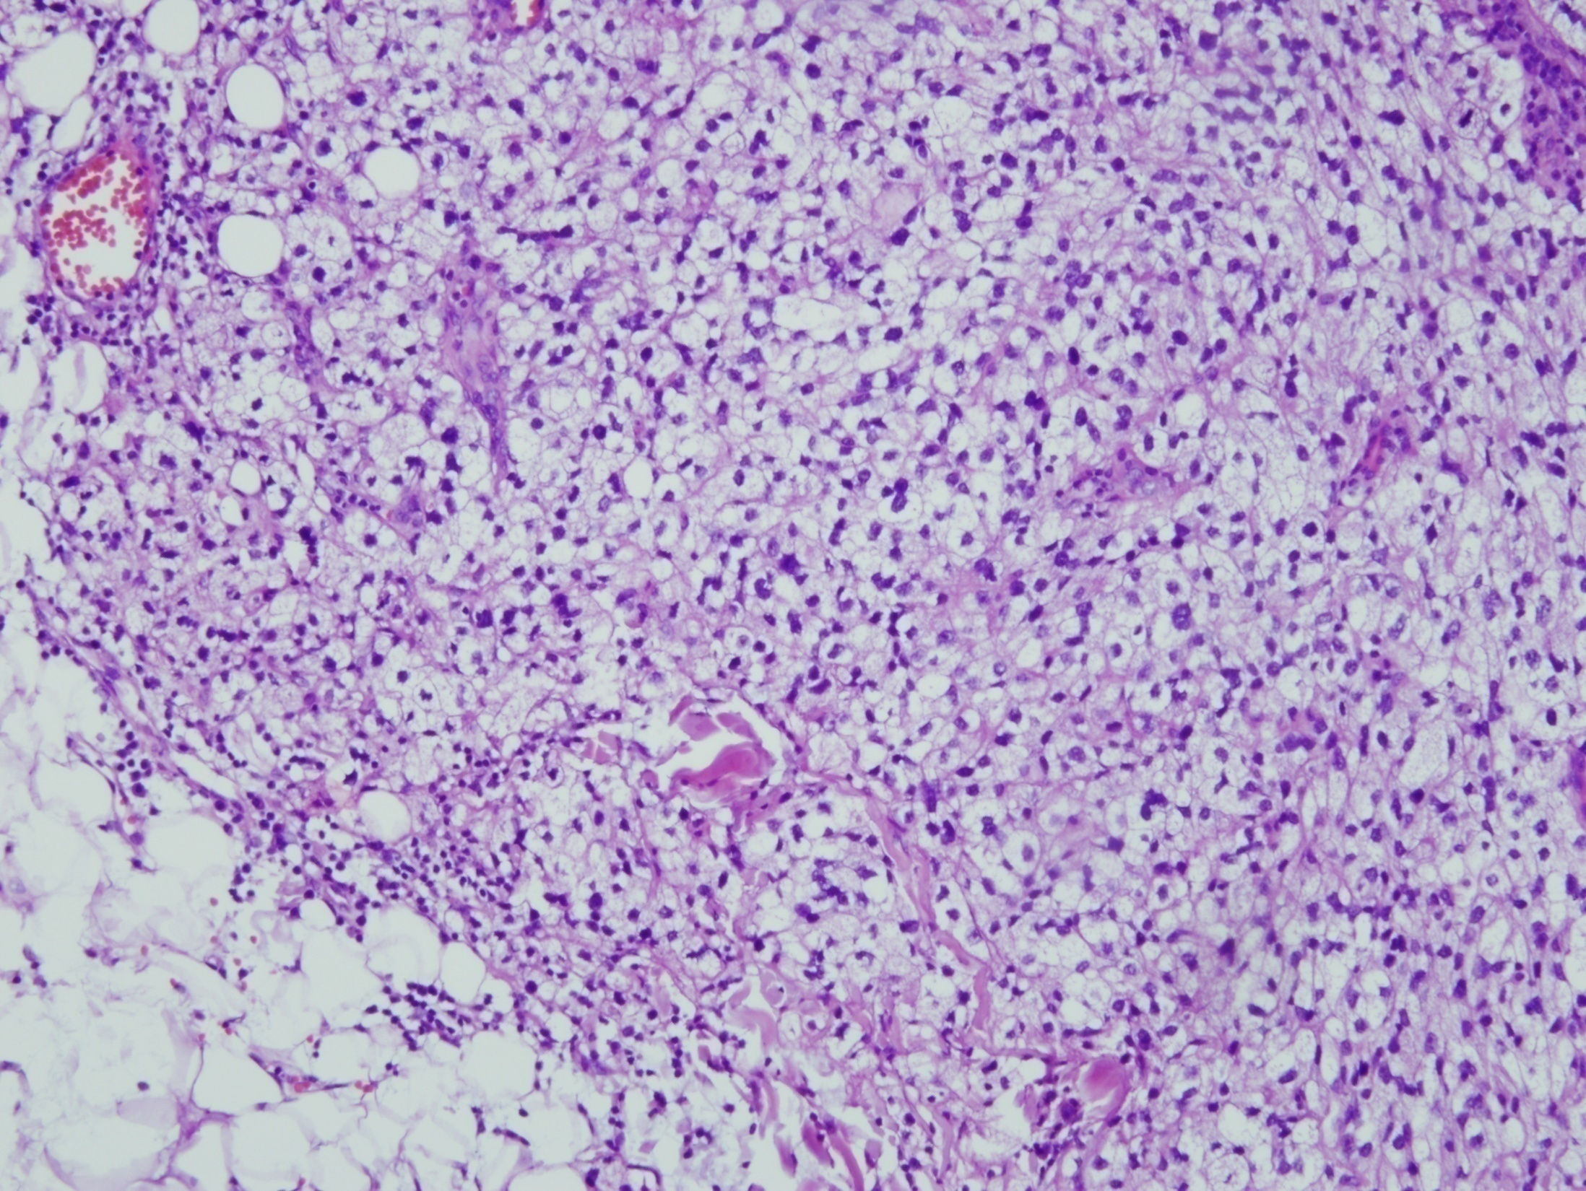

Slide 18
?
Xanthoma ?
Metastasis ? – RCC ?
PEComa ?
Baloon cell melanoma ?
Clear cell dermatofibroma ?
... ?

Slide 19
Immunohistochemistry
Negative
Positive
AE1/AE3, CK7, CK8/18
EMA
CD10
CD68, CD163
S-100
Melan A, HMB45
Vimentin

Slide 20
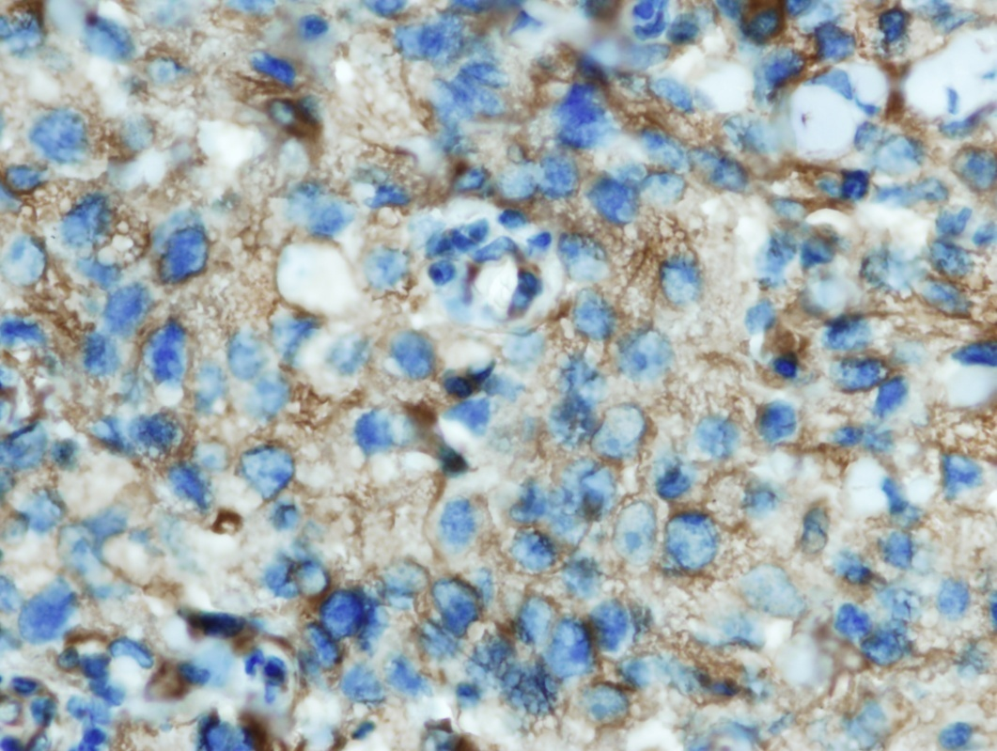
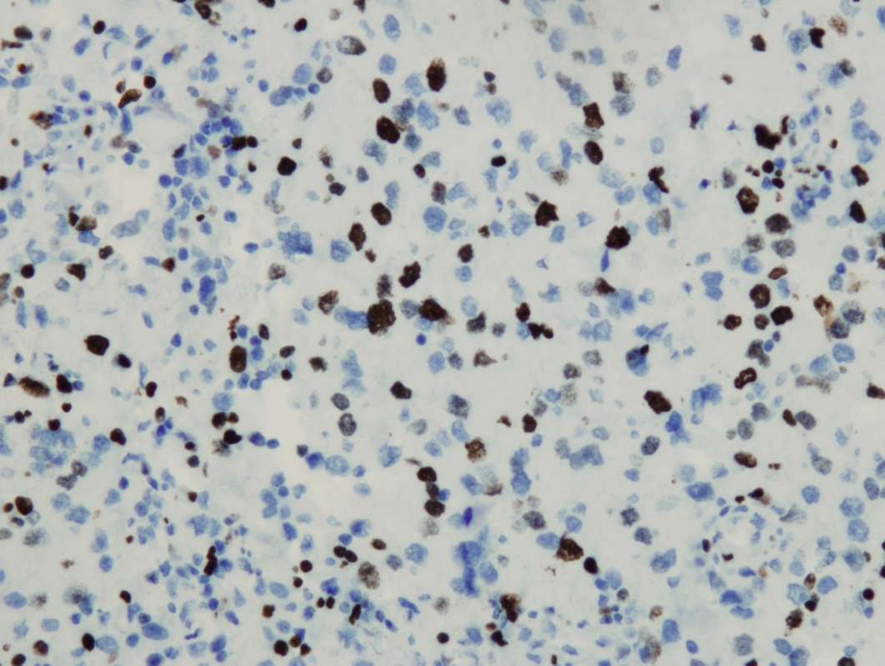
vimentin
Ki-67

Slide 21
?

Slide 22
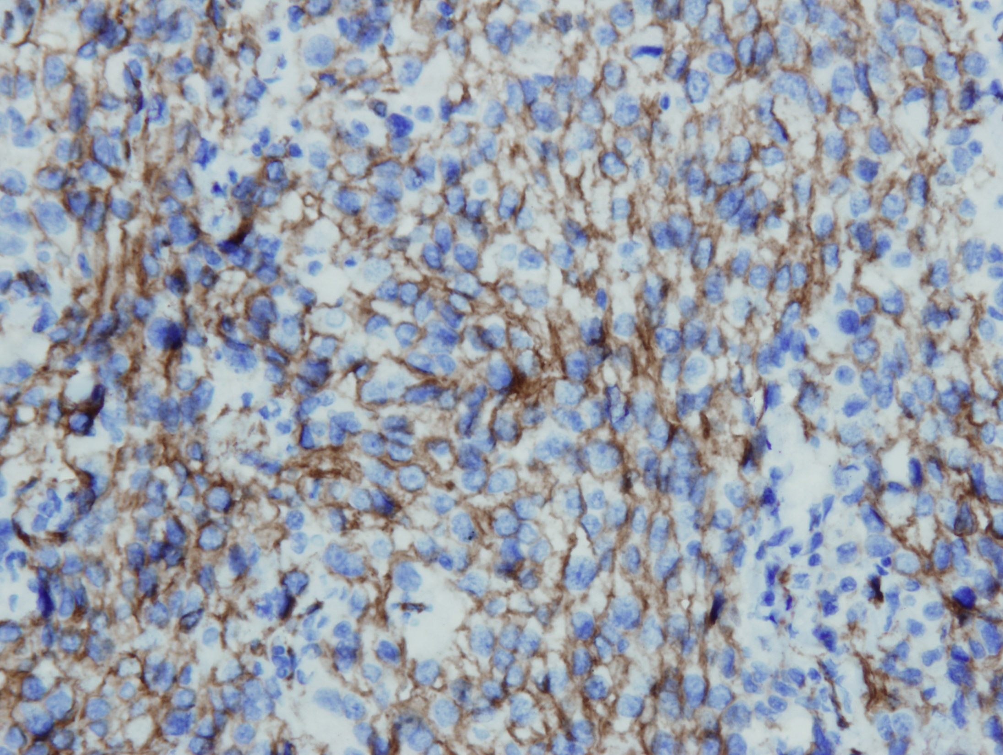
CD31

Slide 23
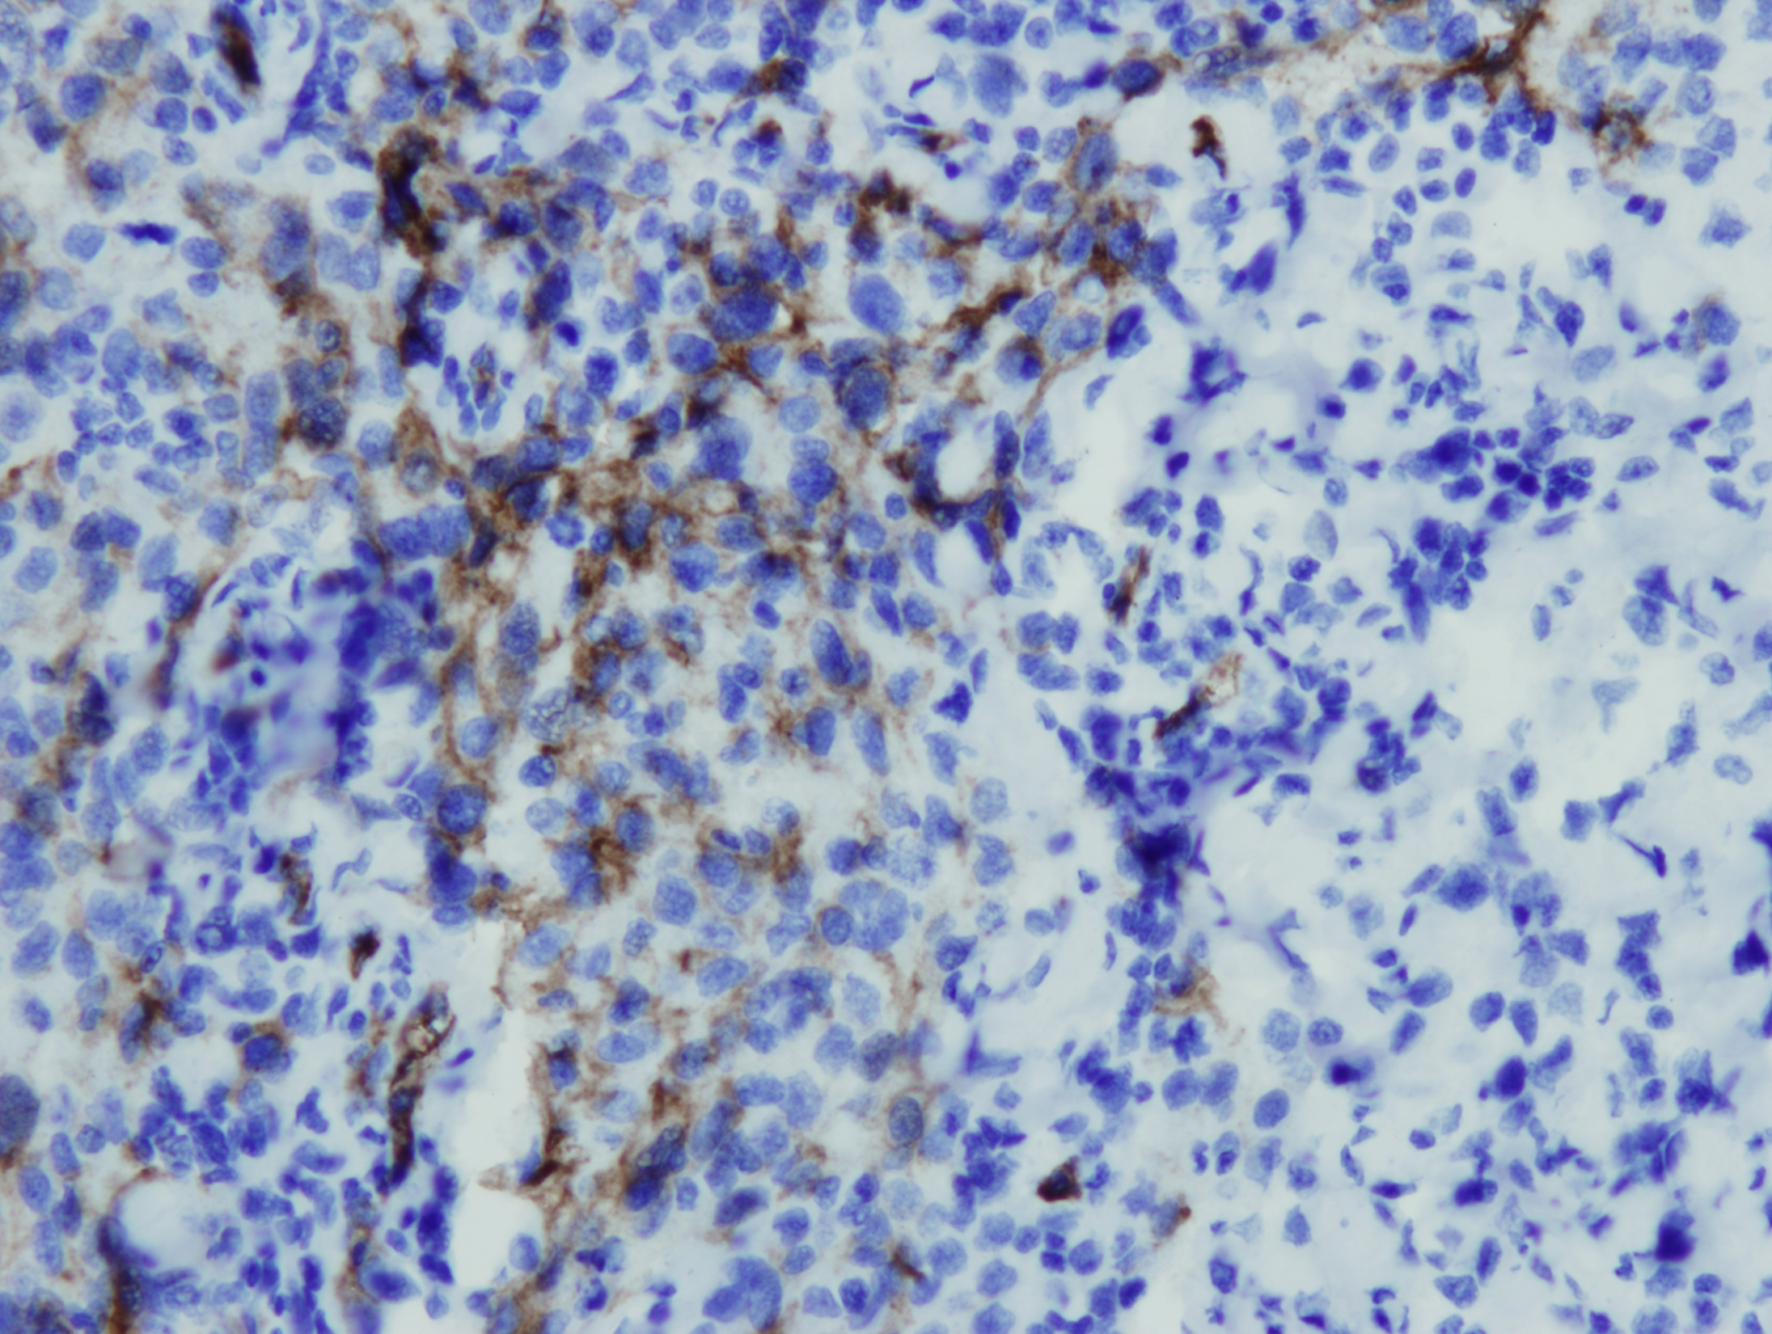
CD34

Slide 24
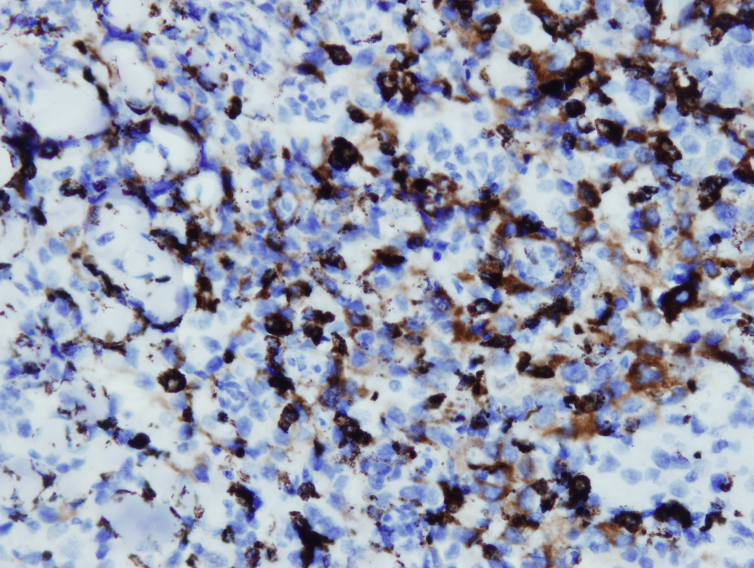
D2-40

Slide 25
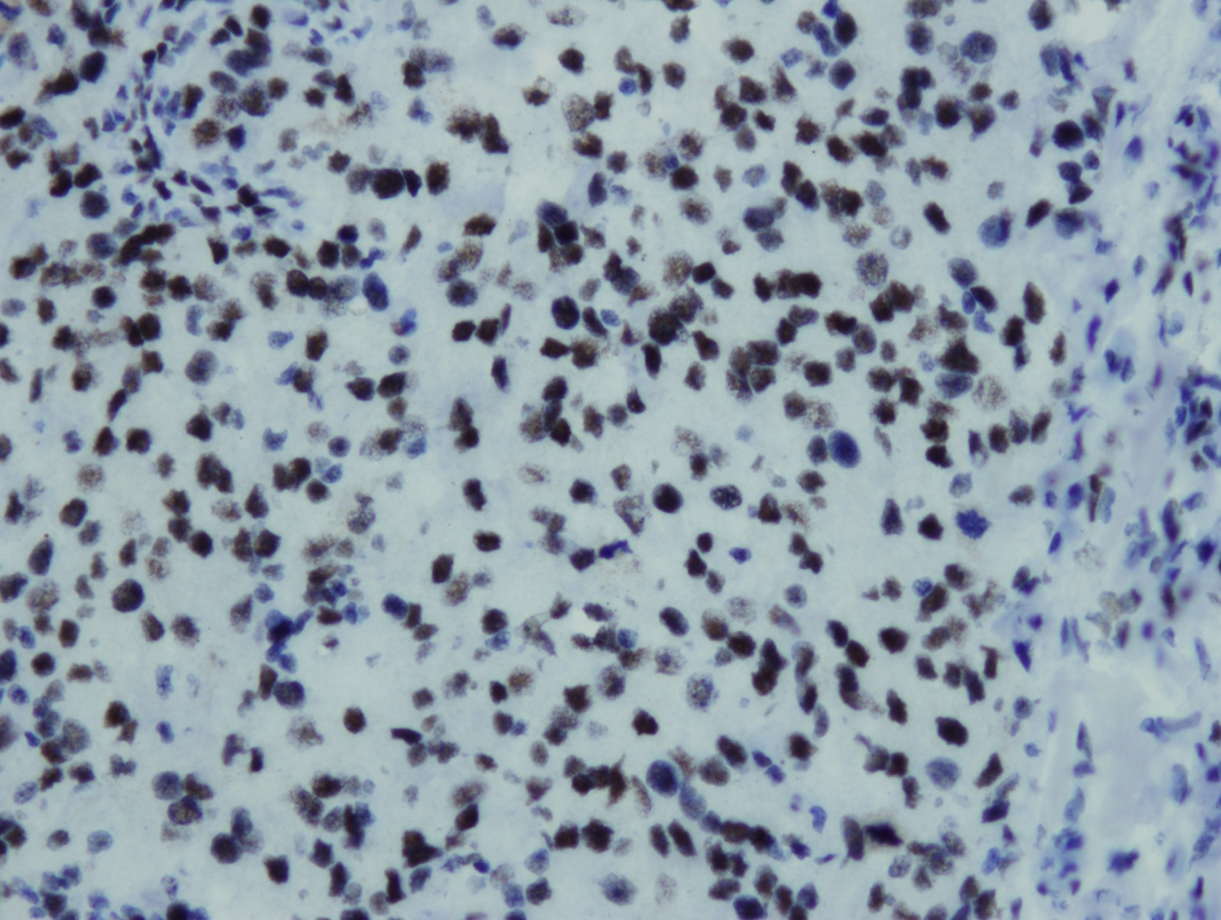
FLI1

Slide 26
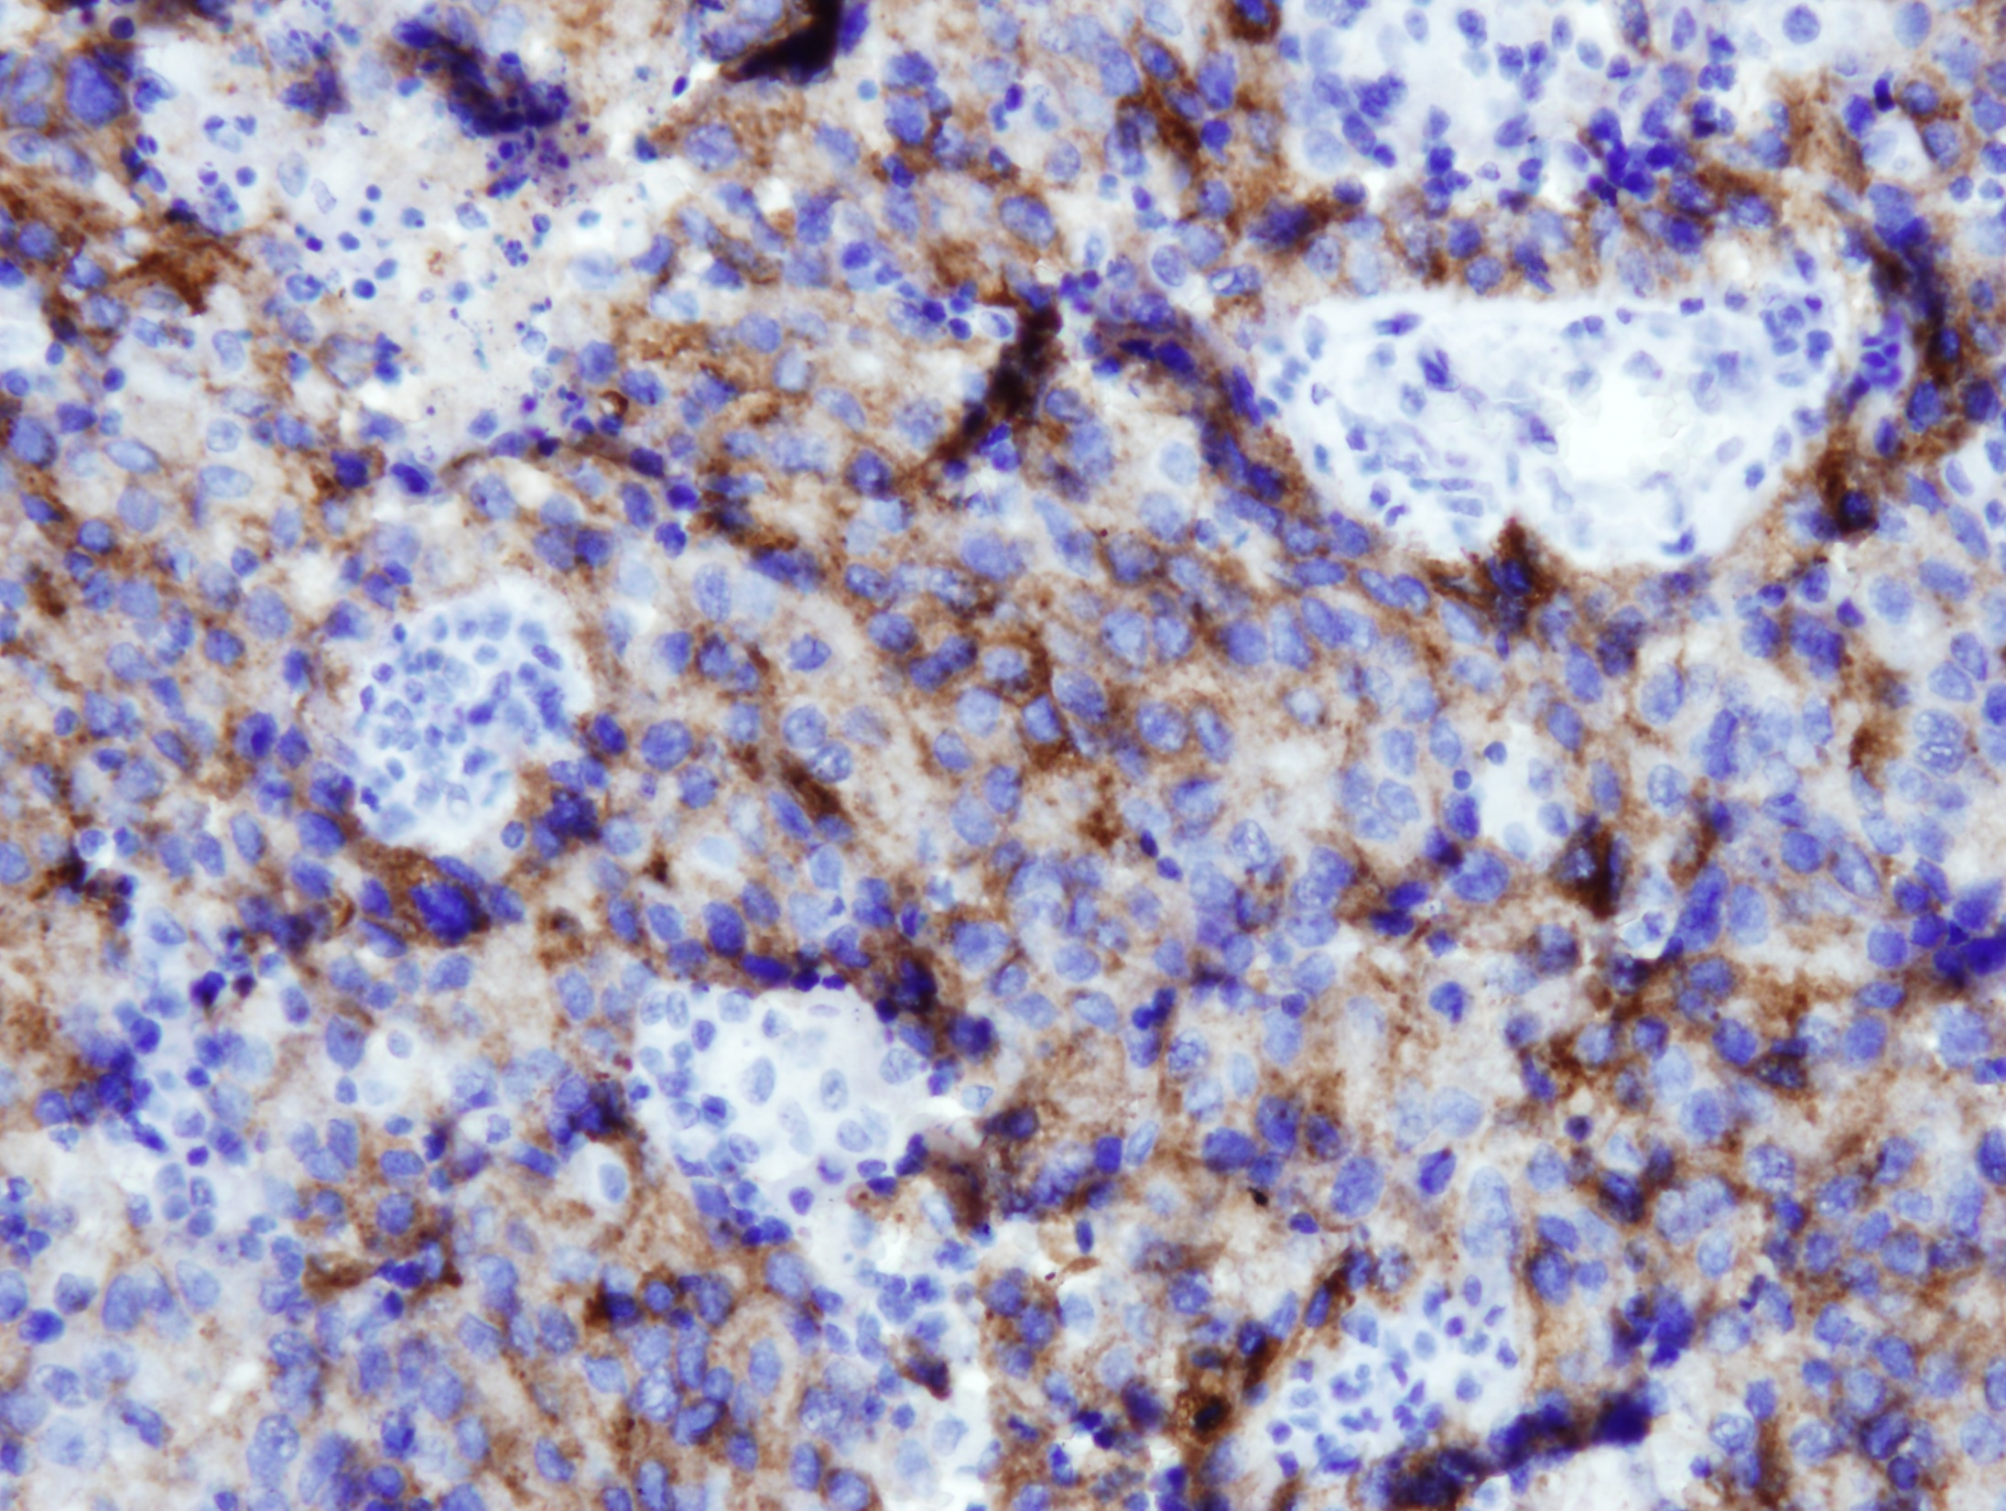
CD117

Slide 27
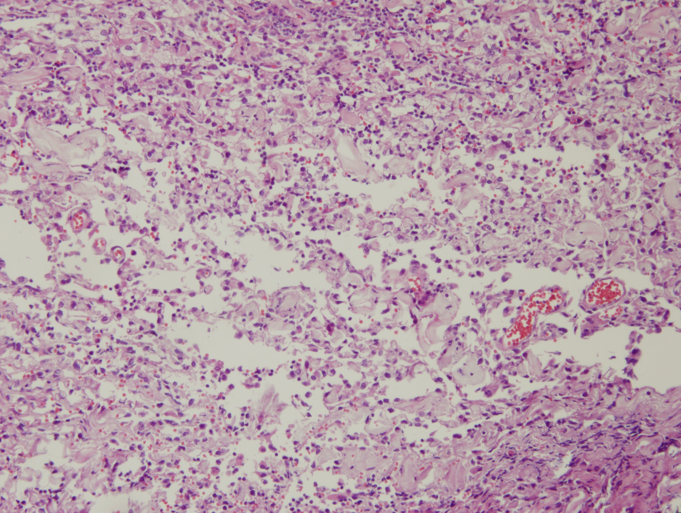

Slide 28
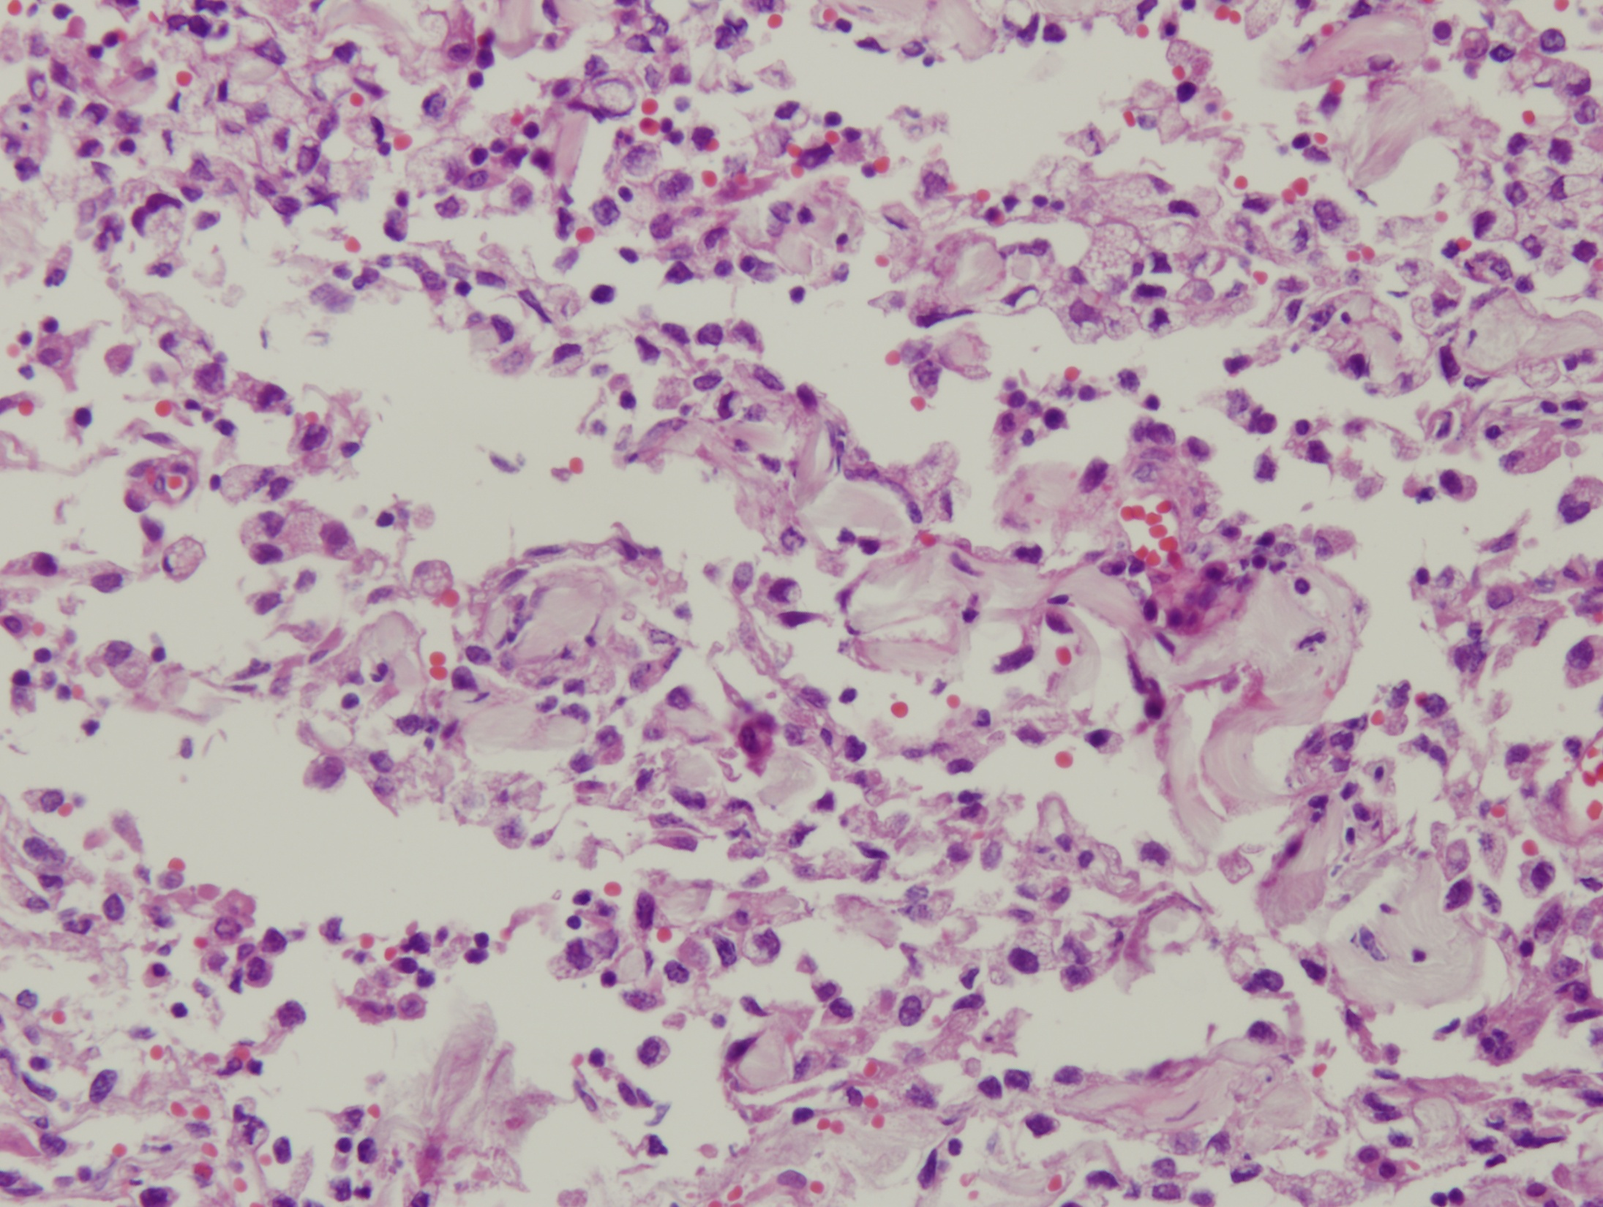

Slide 29
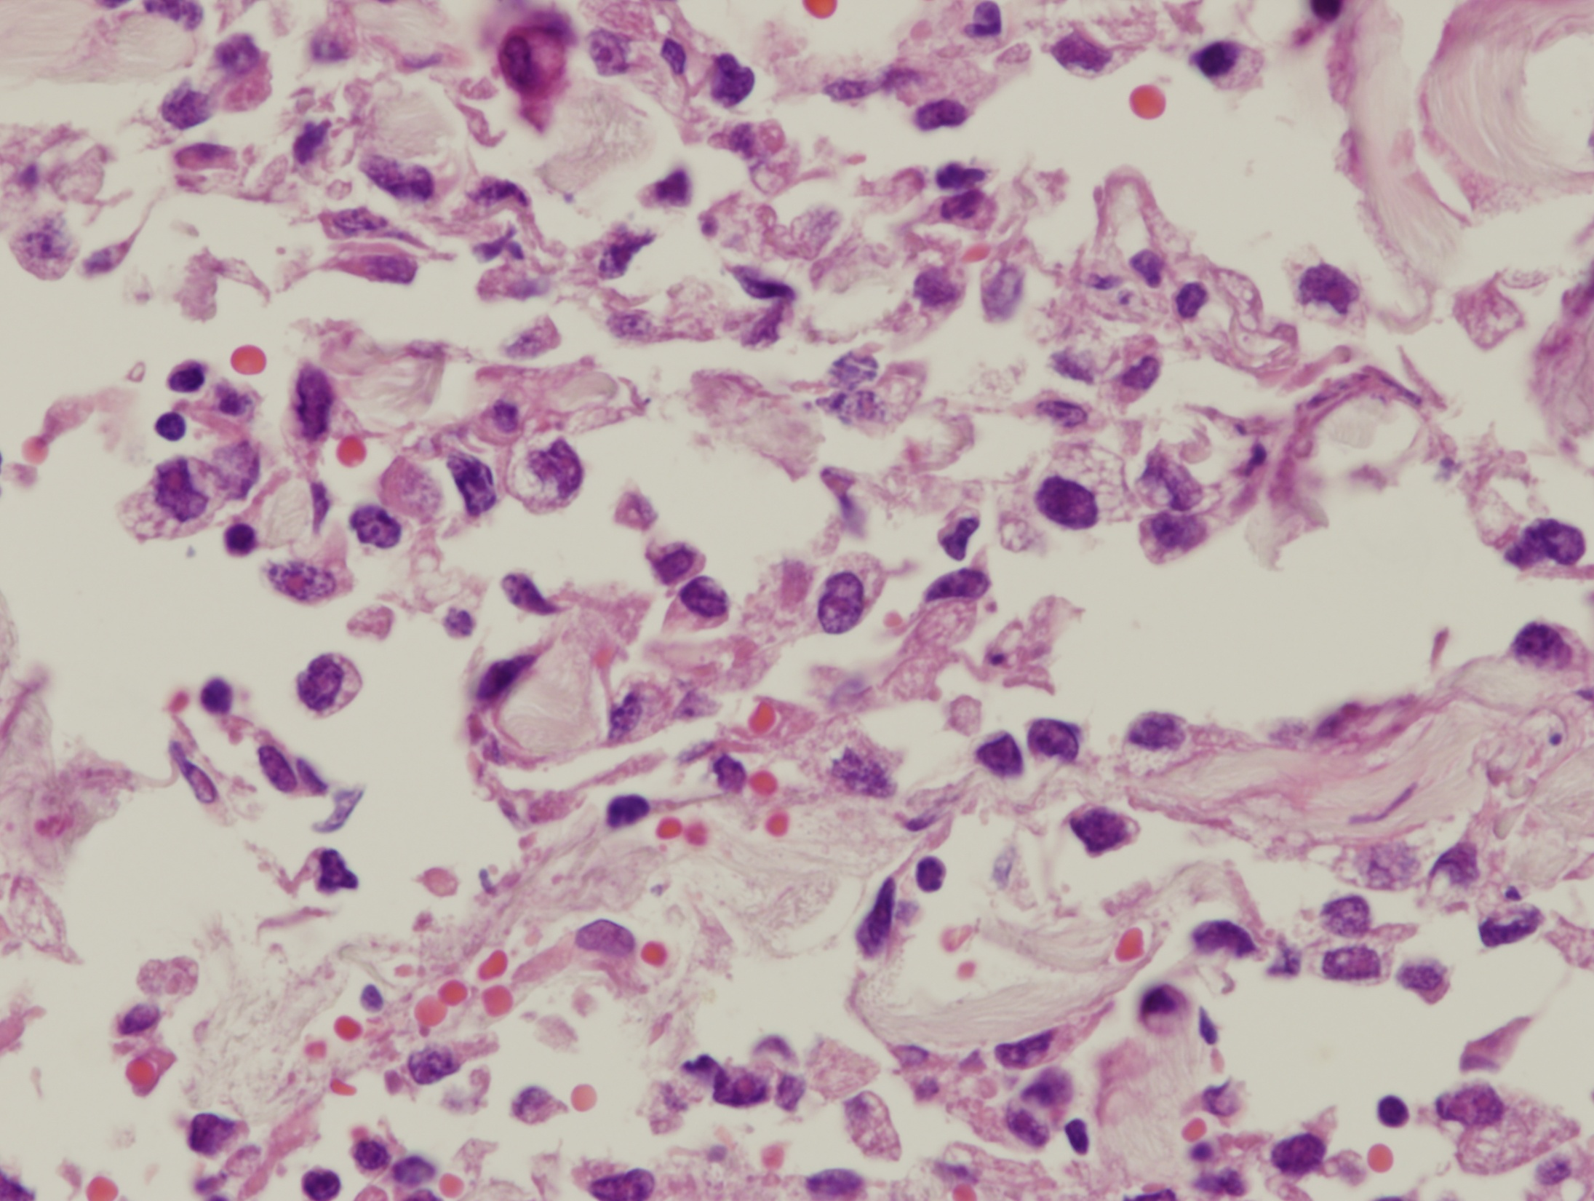
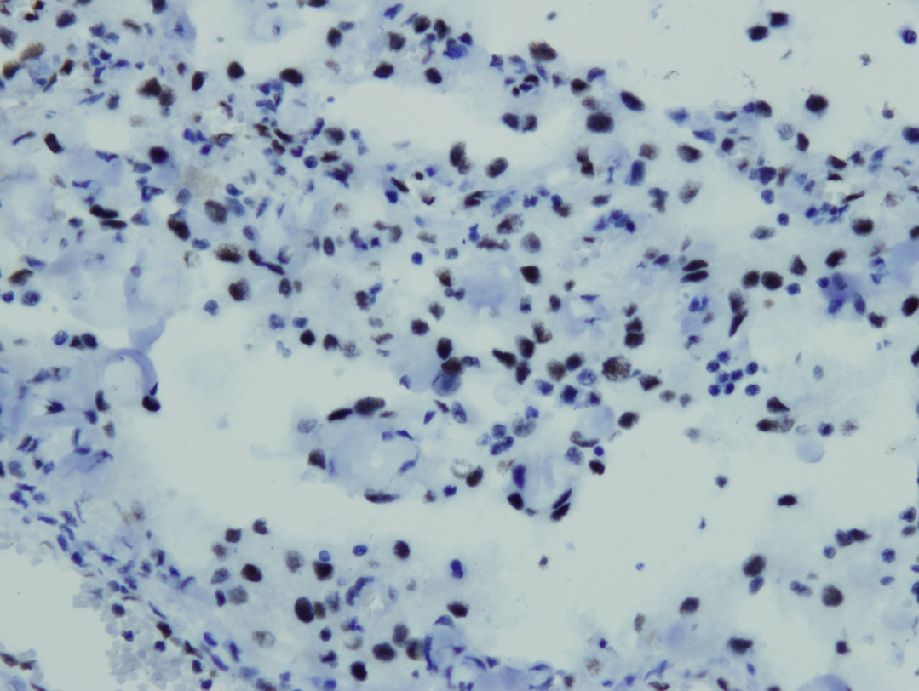
FLI1

Slide 30
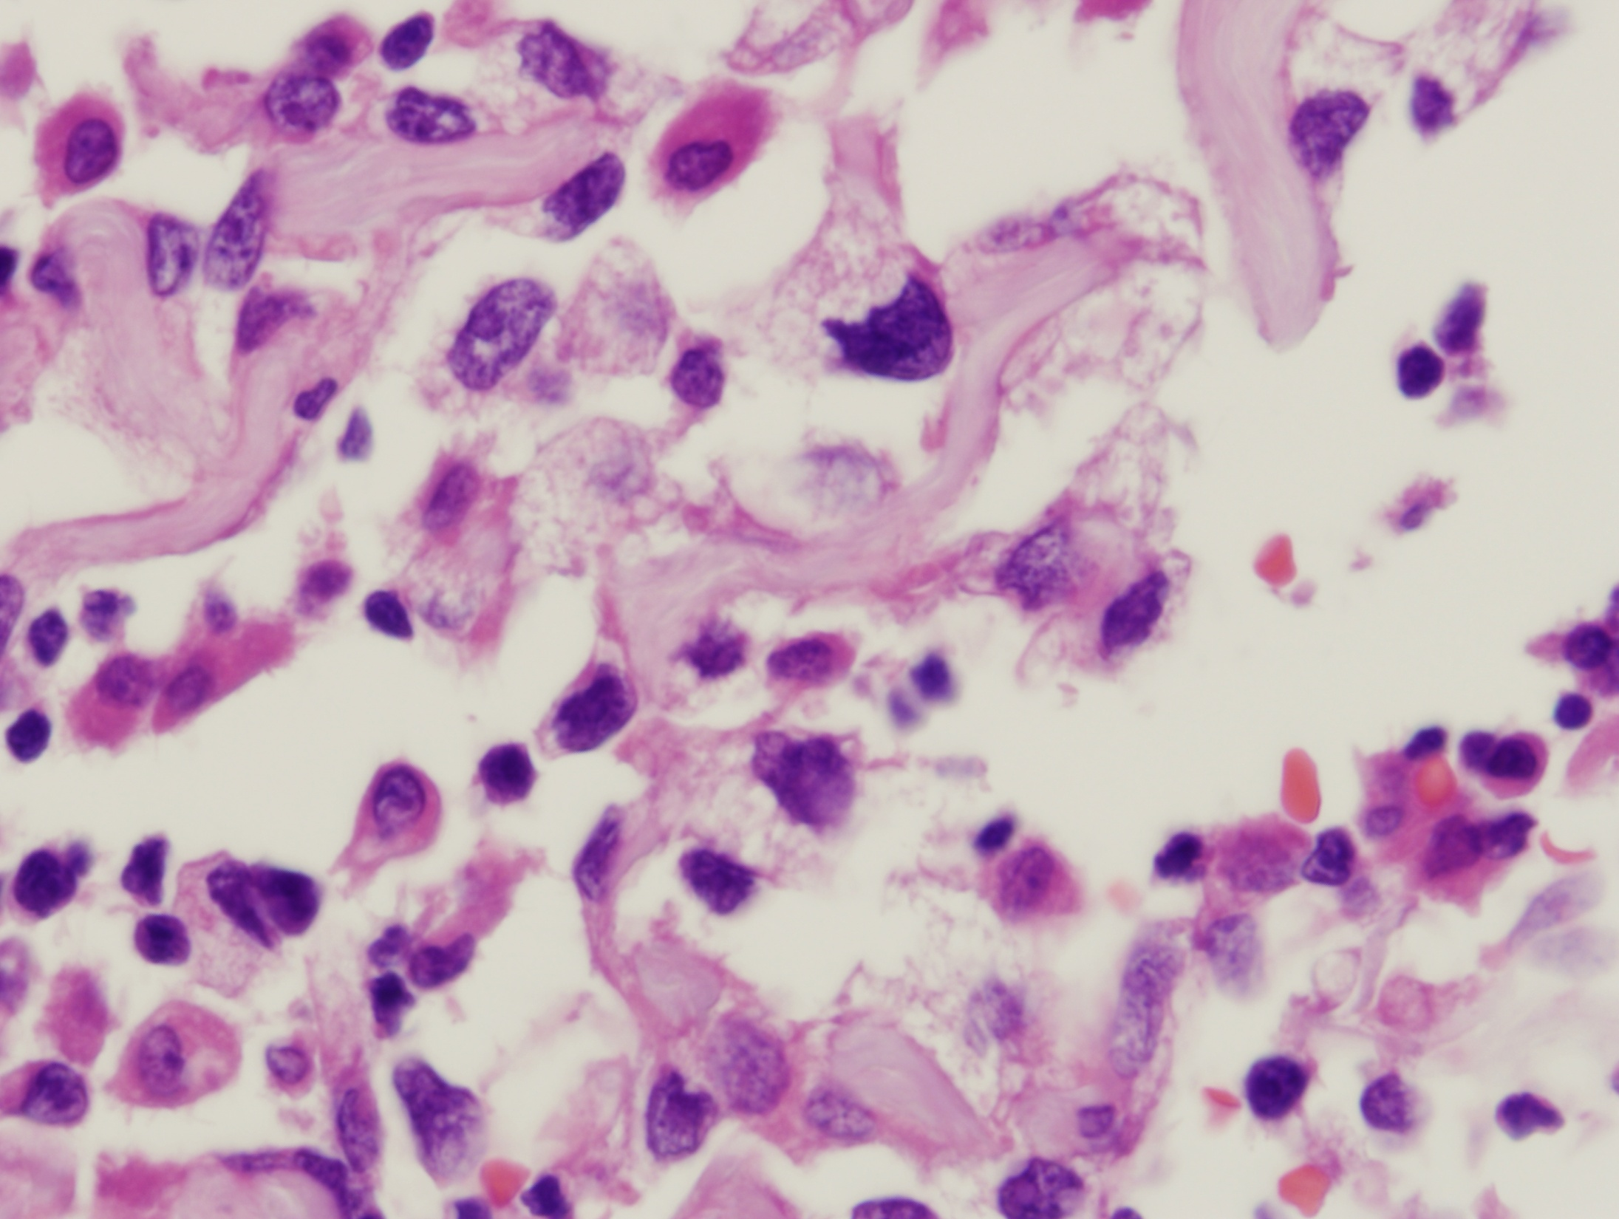

Slide 31
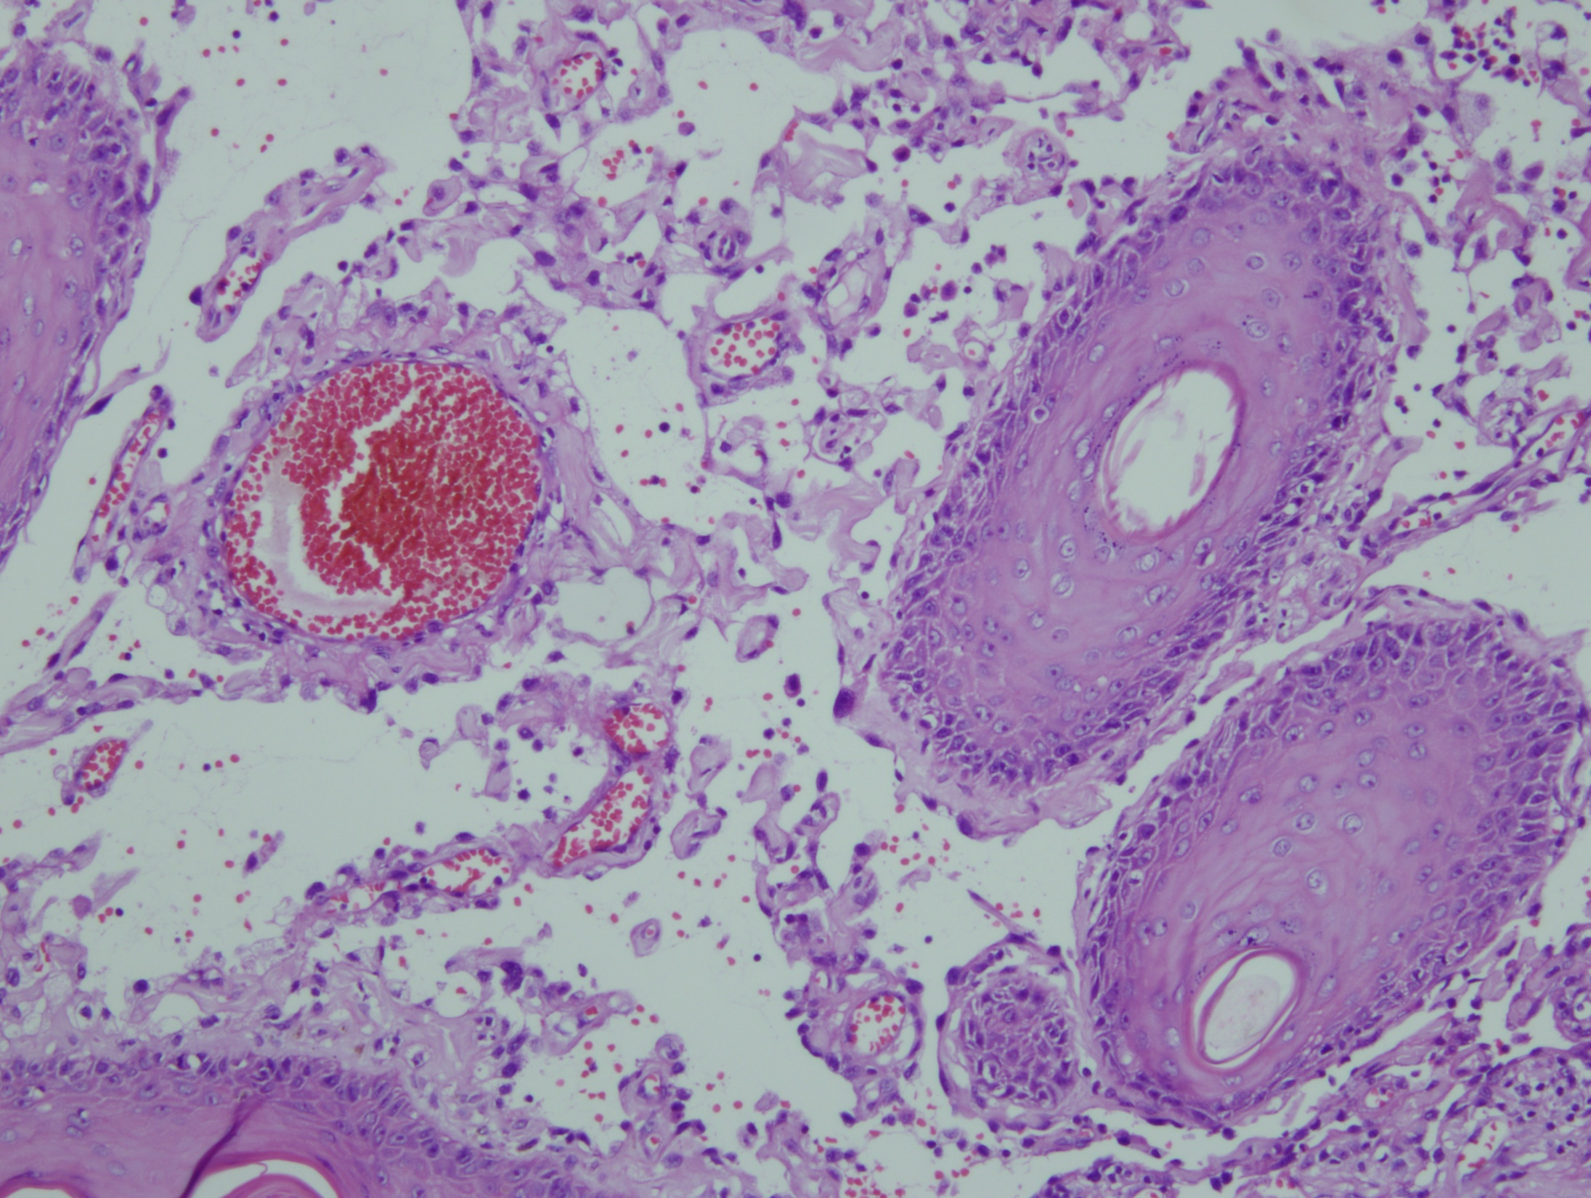

Slide 32
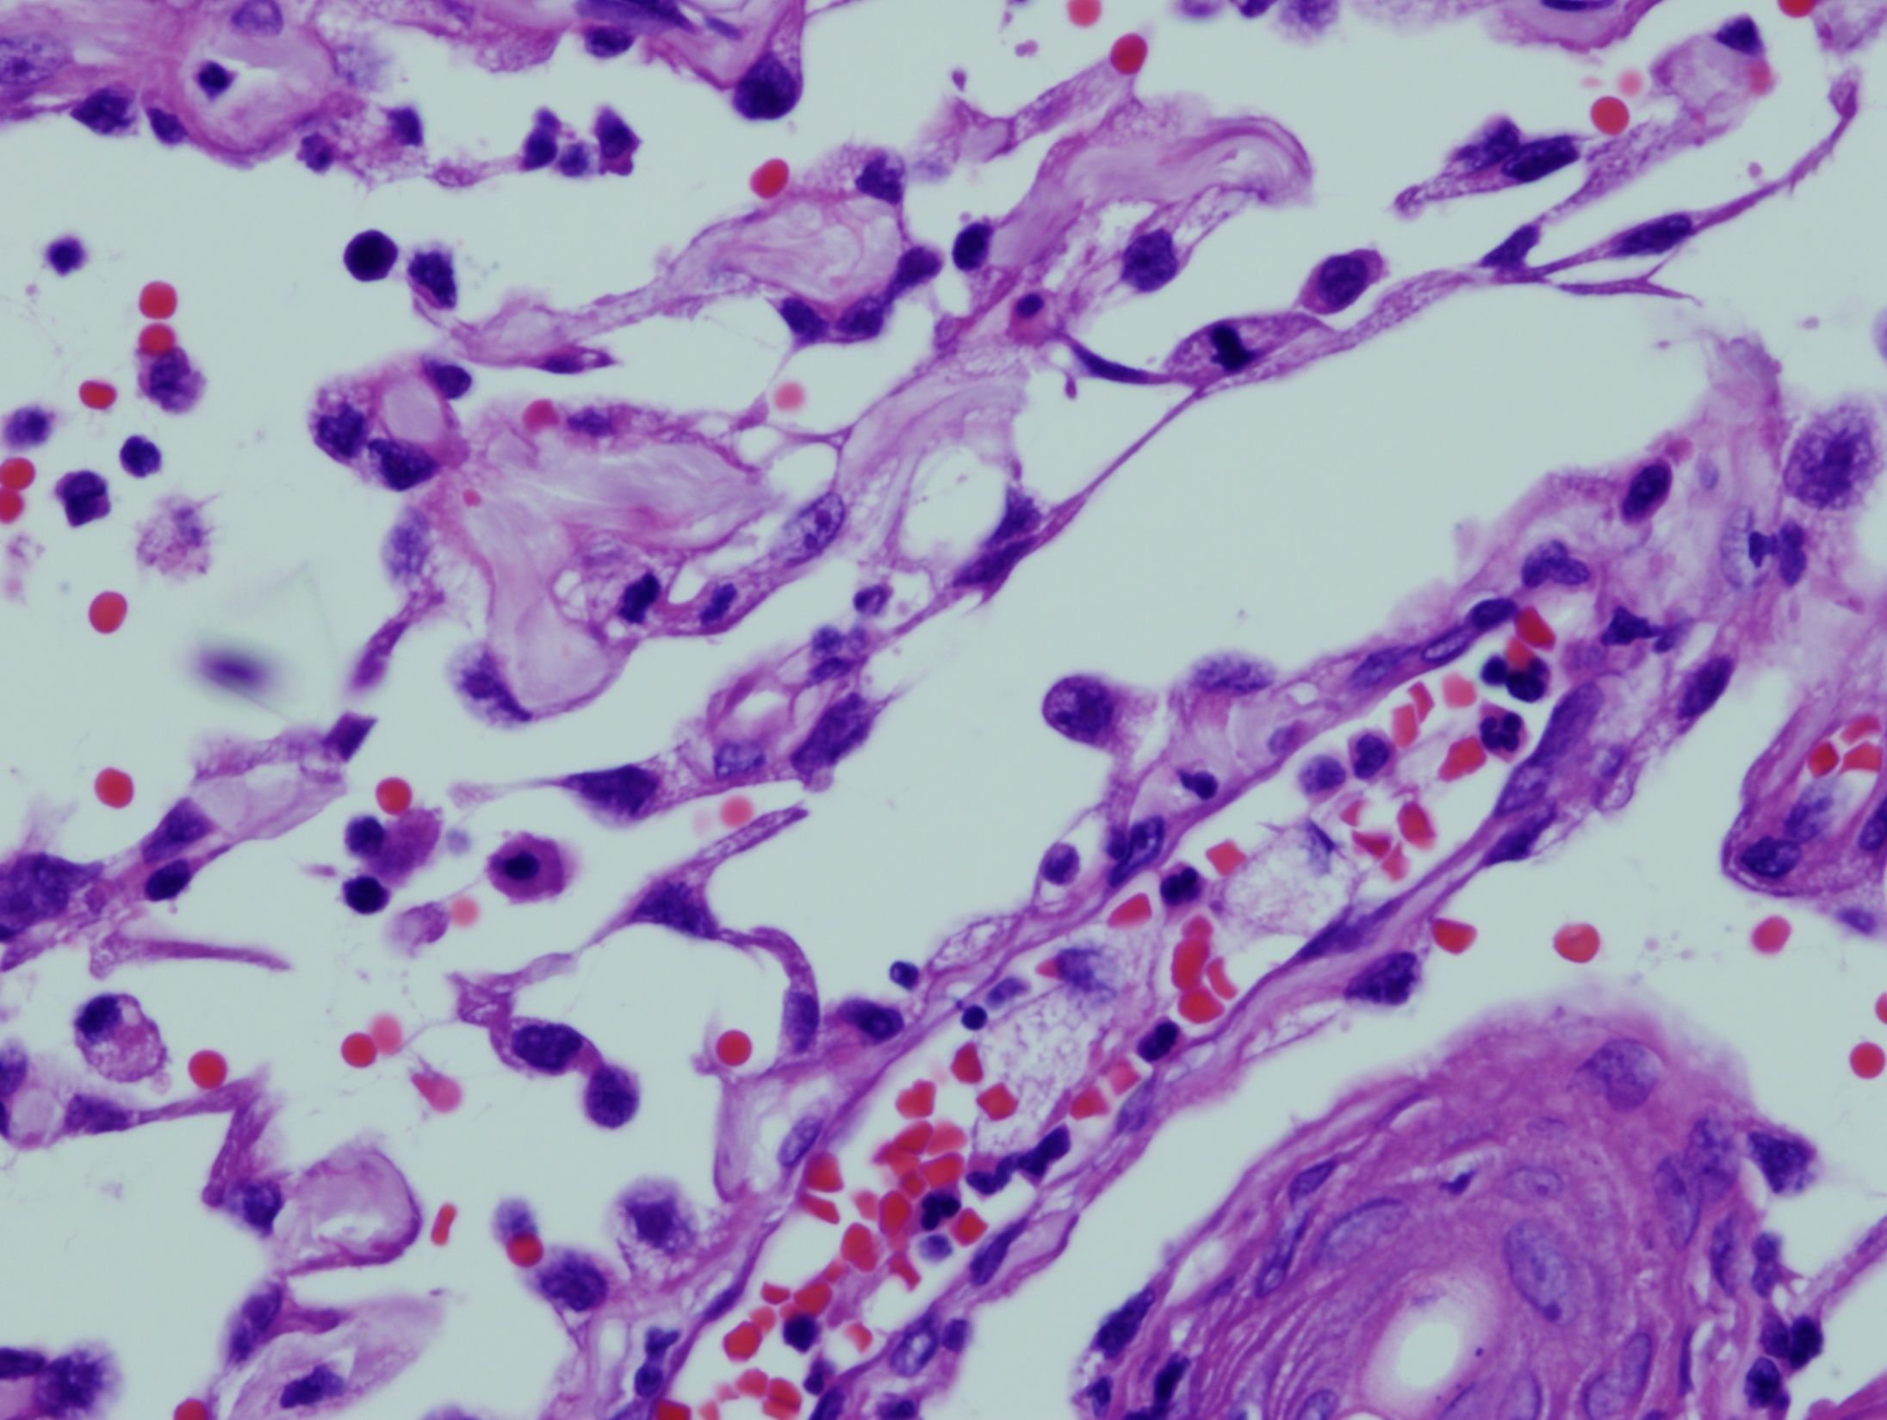

Slide 33
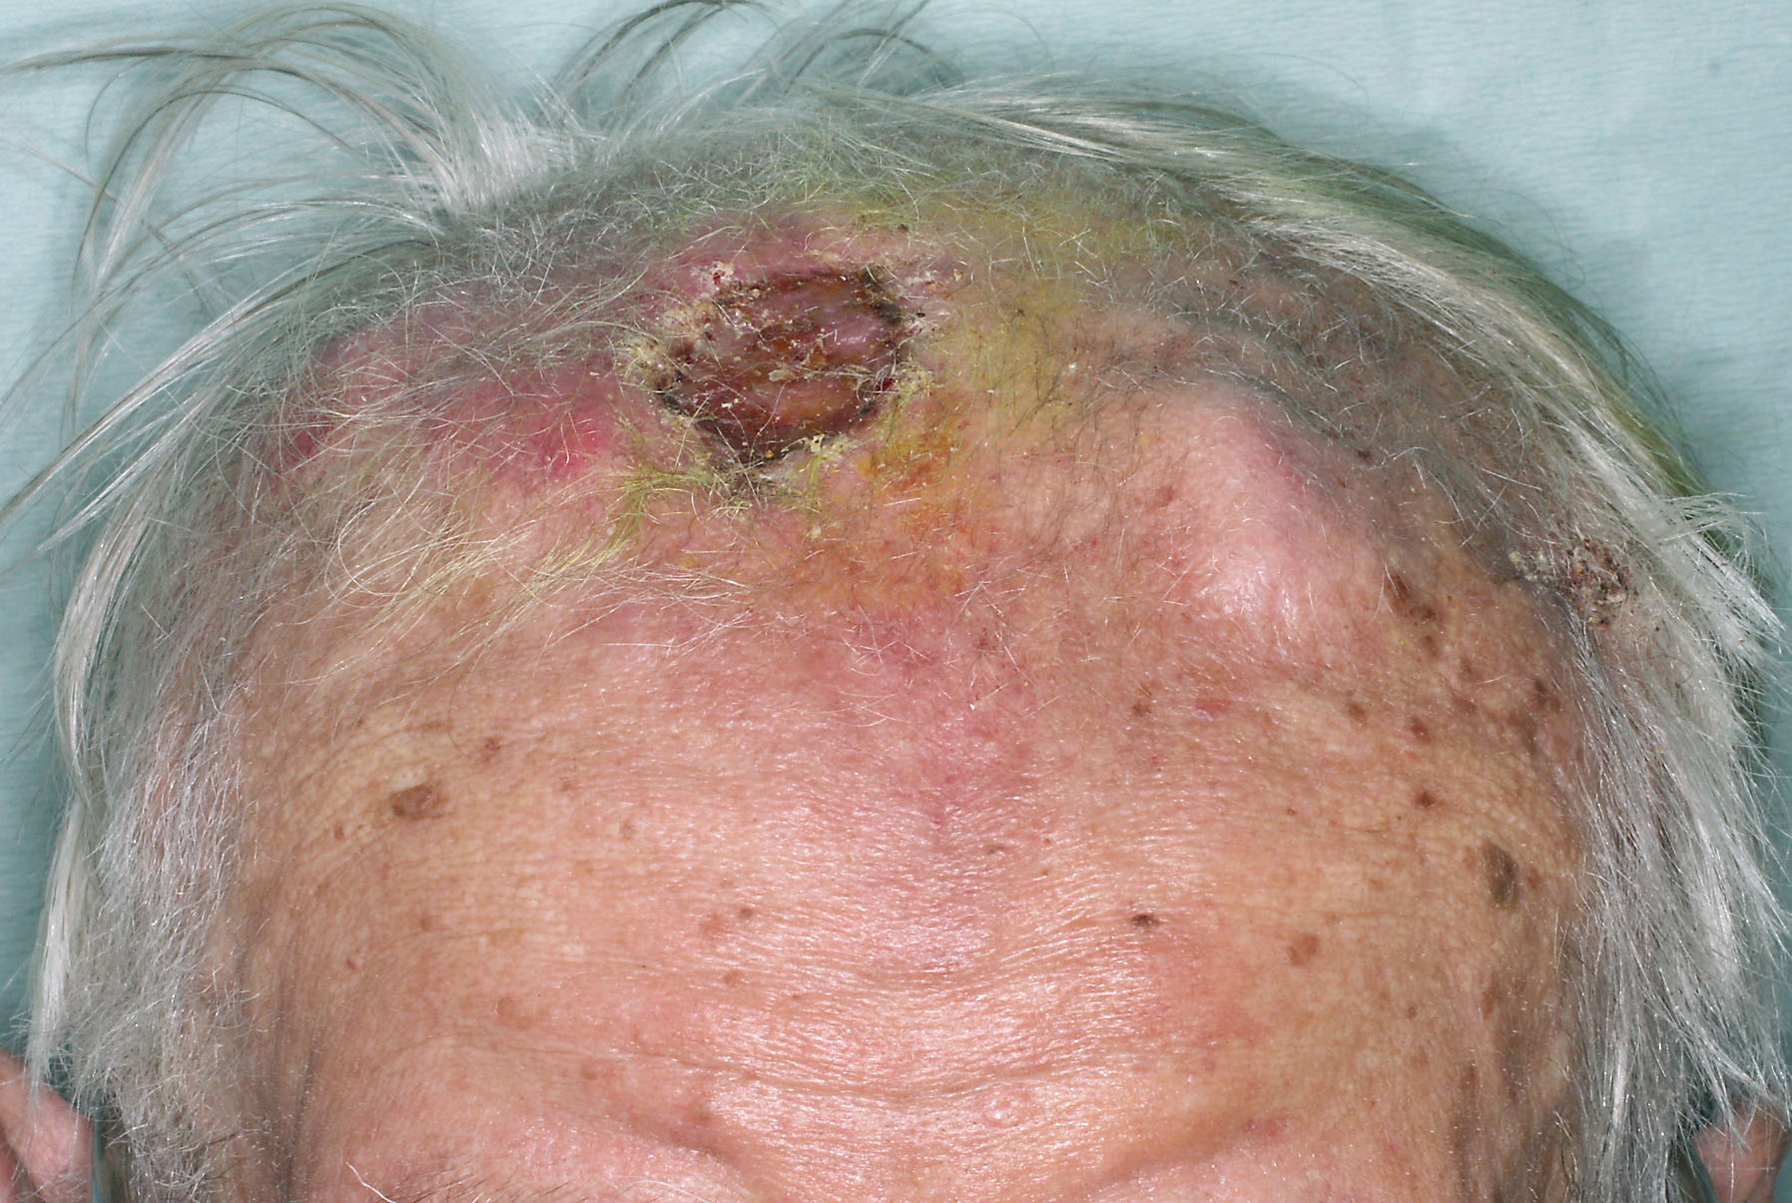

Slide 34
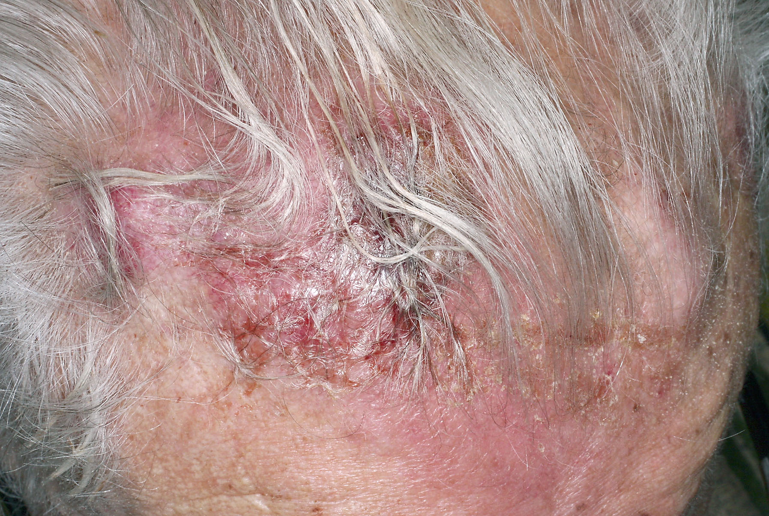

Slide 35
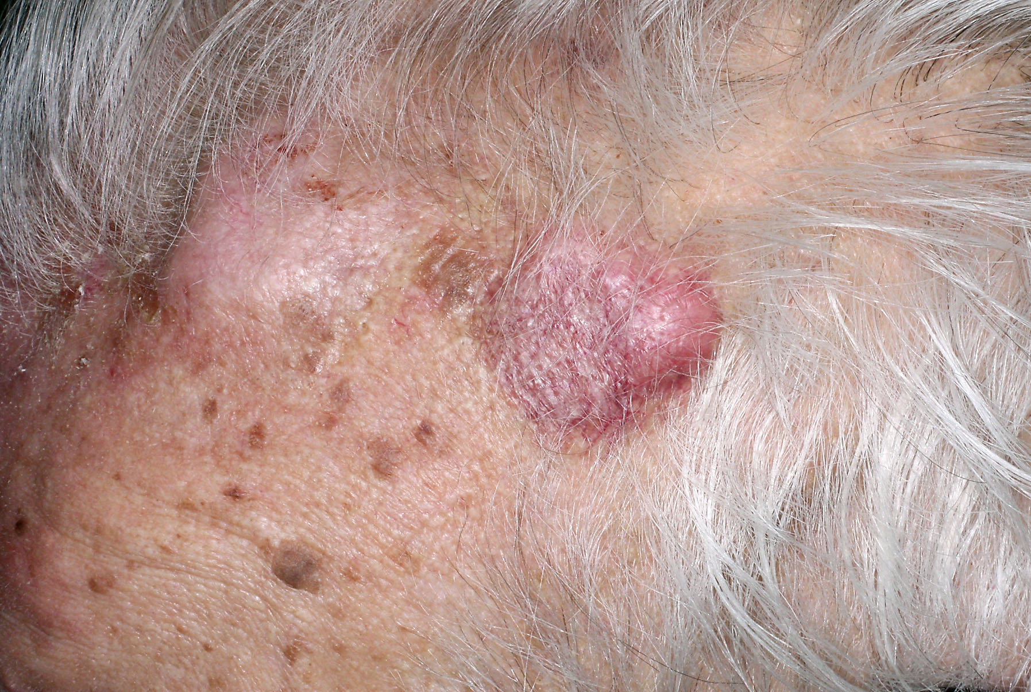

Slide 36
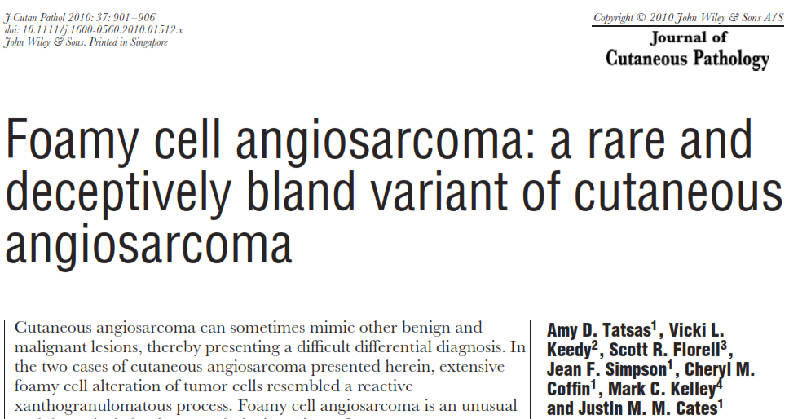

Slide 37
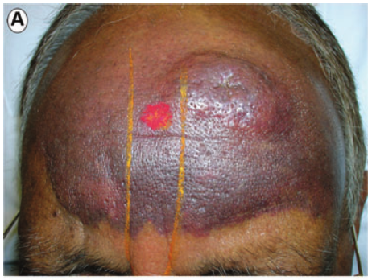
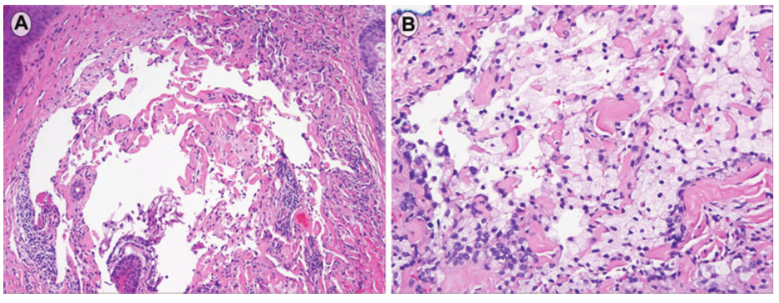
Tatsas et al. J Cutan Pathol 2010; 37: 901–906.

Slide 38
Ackerman AB, Guo Y, Vitale PA, Vossaert K. Clues to diagnosis in dermatopathology. Chicago: ASCP Press, 1993; 357.

Slide 39
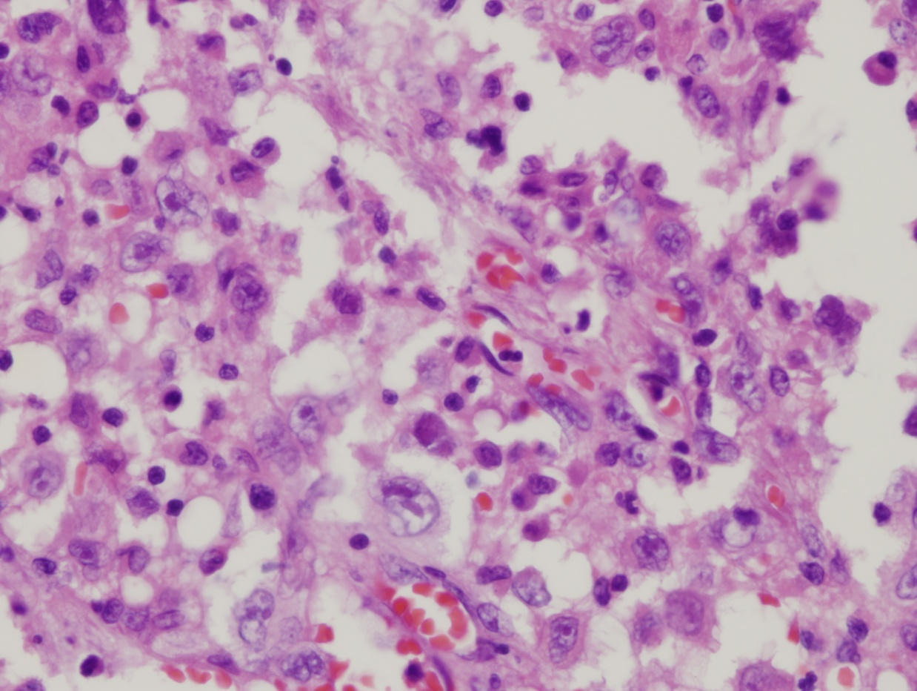
Angiosarcoma DDX: Immunohistochemistry
Tumor of the stomach, sent in consultation as a possible angiosarcoma

Slide 40
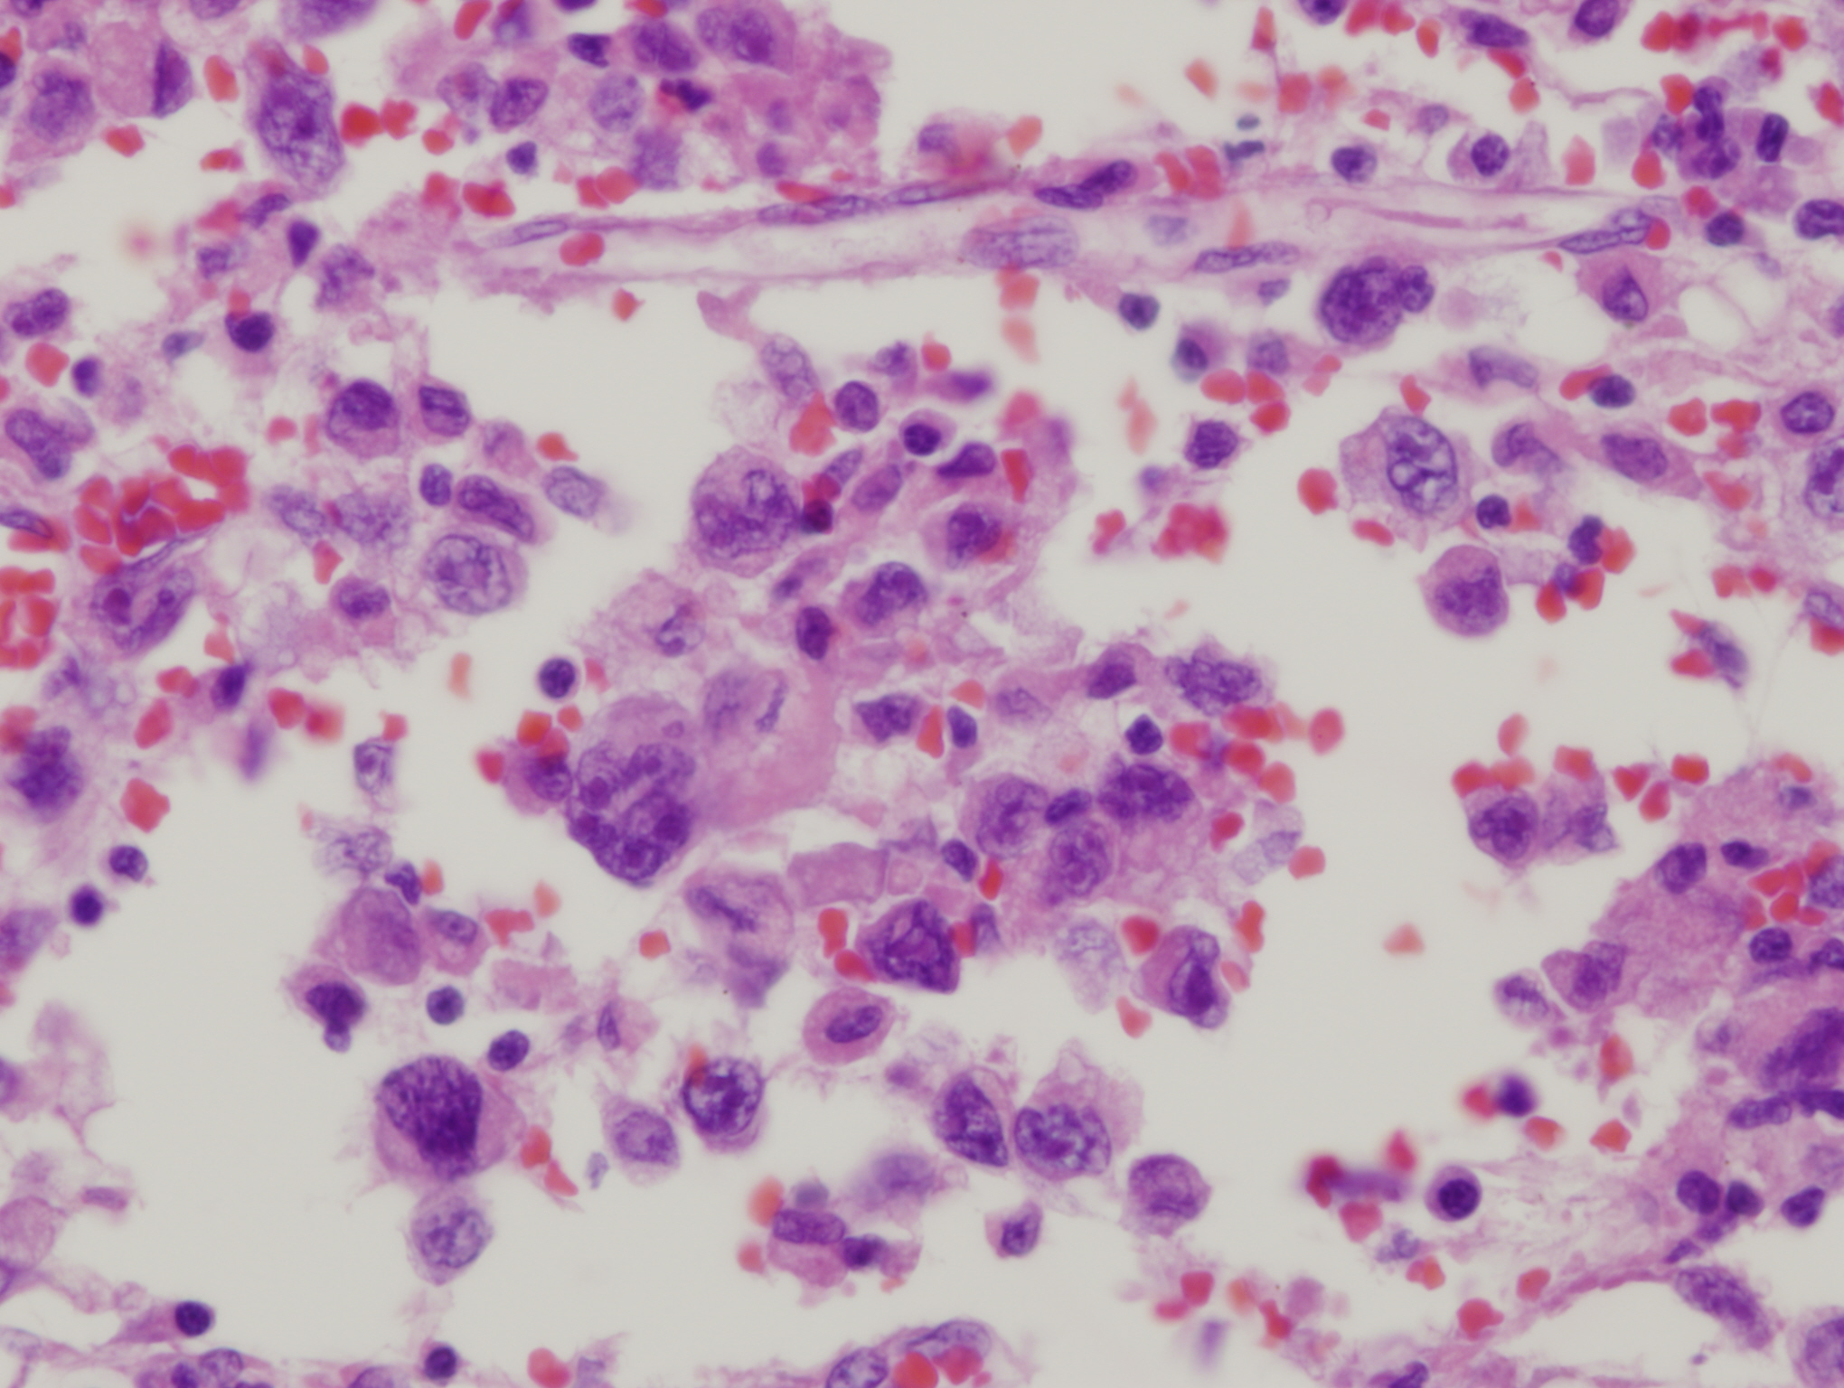

Slide 41
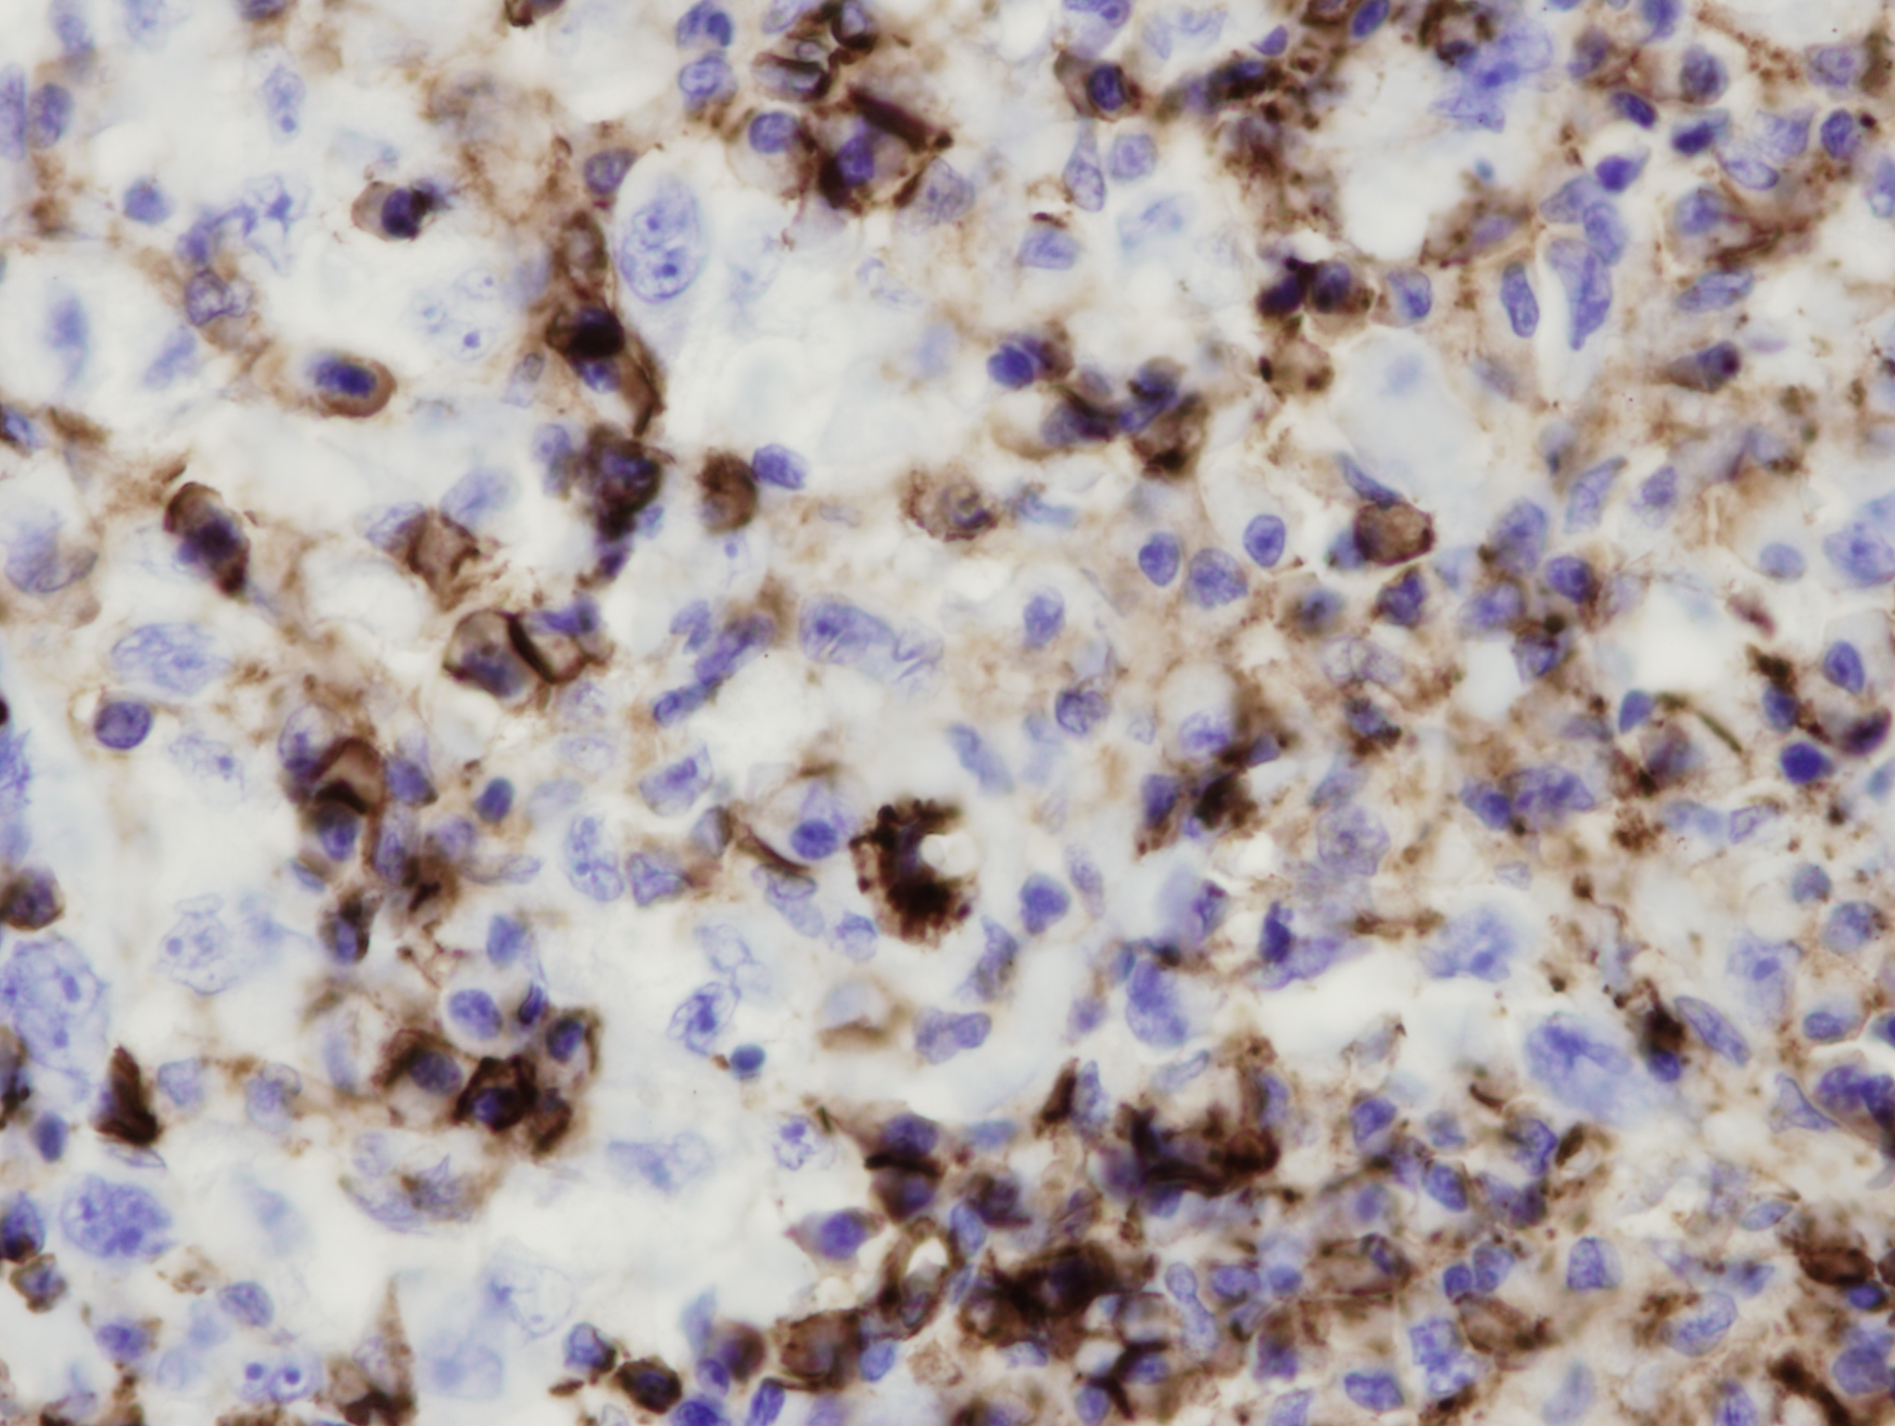
CD31

Slide 42
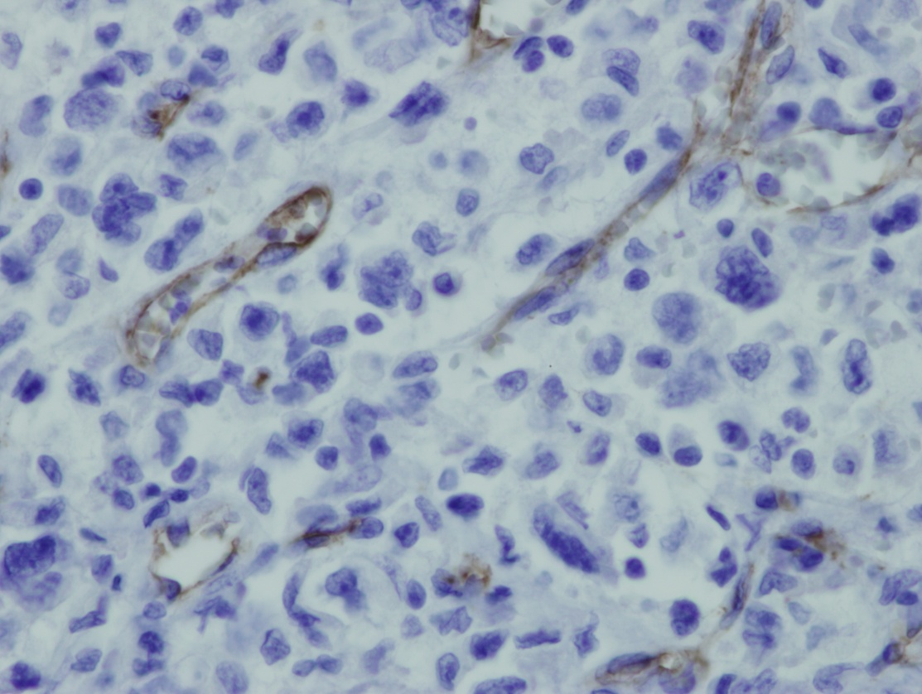
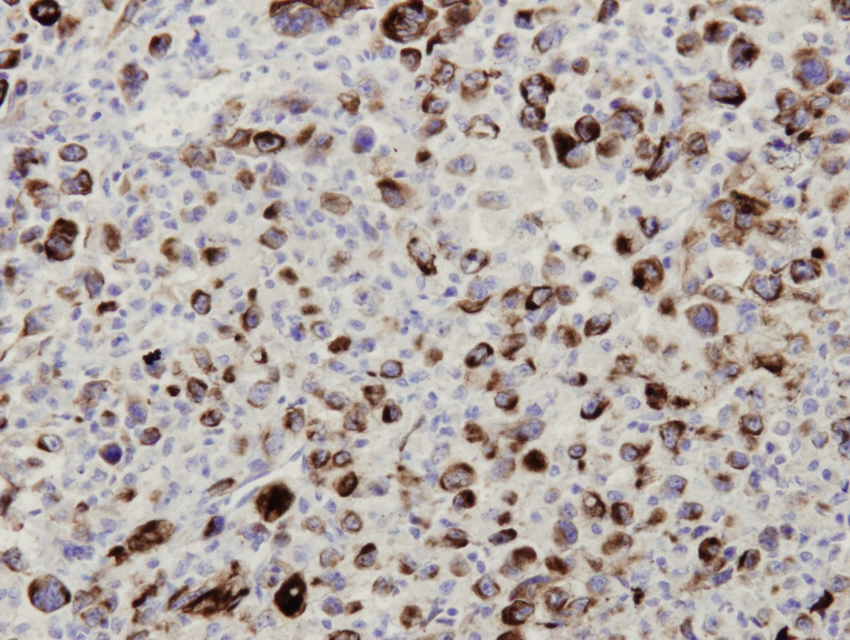
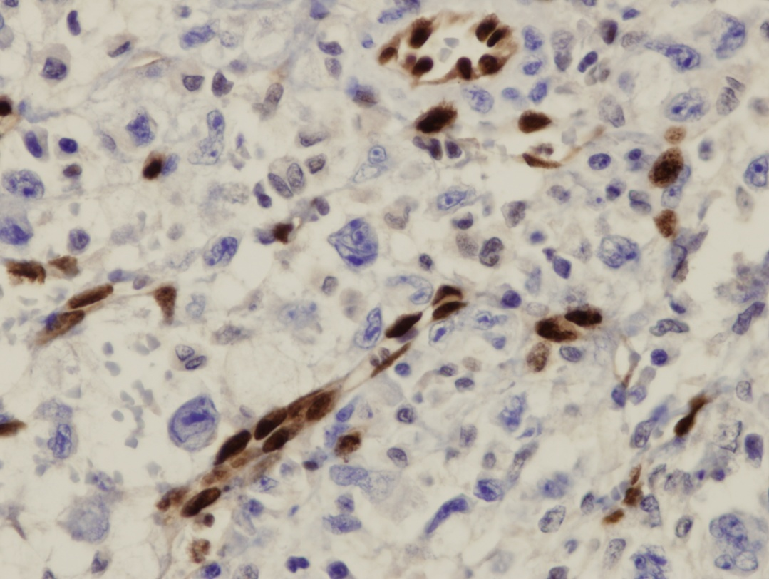
CD34
AE1/AE3
Non-specific FLI positivity
ERG

Slide 43
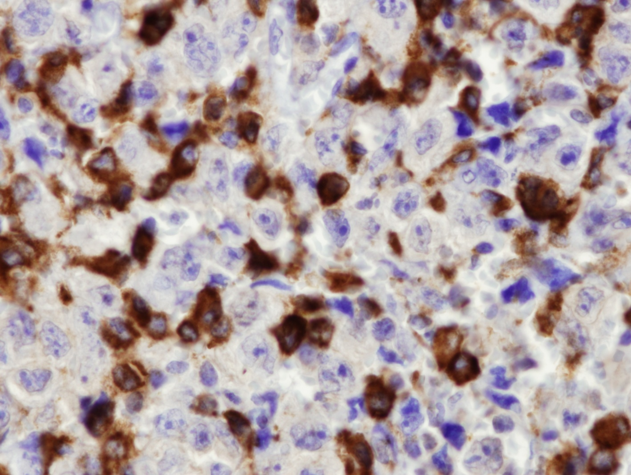
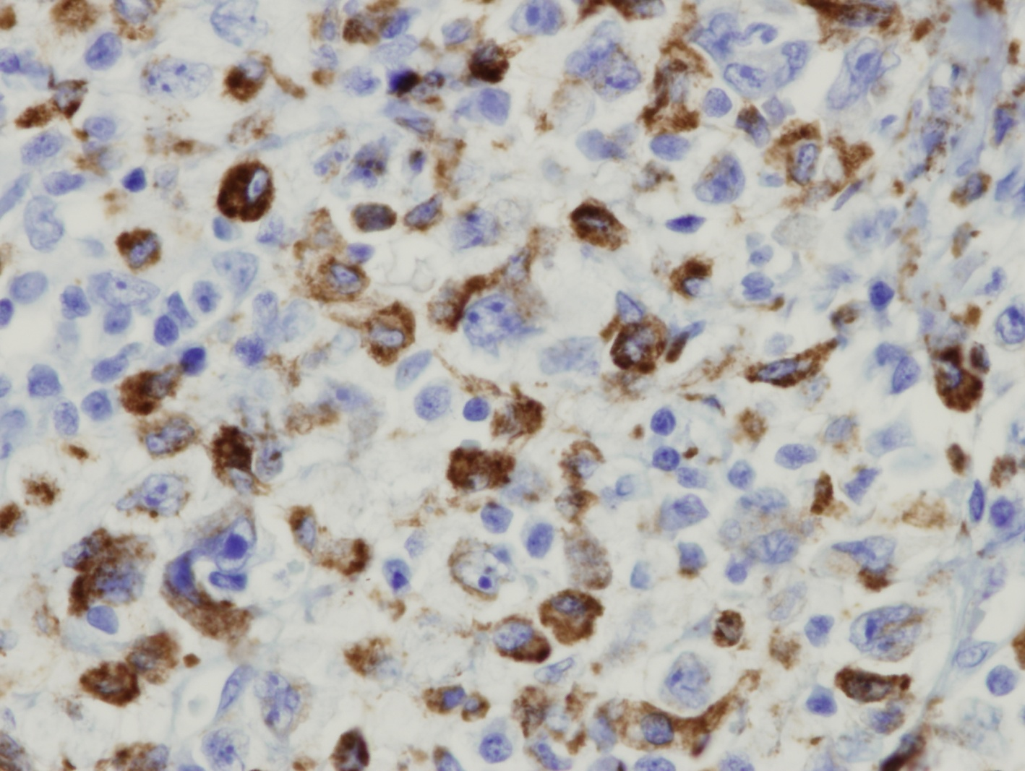
CD68
CD163

Slide 44
McKenney JK, Weiss SW, Folpe AL. CD31 expression in intratumoral macrophages : a potential diagnostic pitfall.
Am J Surg Pathol 2001; 25: 1167

Slide 45
McKay KM et al. Expression of ERG, an Ets family transcription factor, distinguishes cutaneous angiosarcoma from histological mimics.
Histopathology 2012; 61(5): 989–991.
ERG: 100% sensitivity 100% specificity
VS
FLI1: 100% sensitivity 29% specificity
SO FAR .... ☺

Slide 46
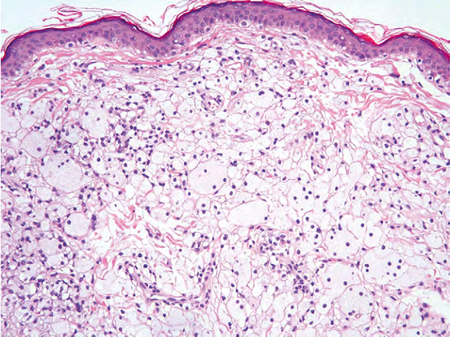
DDX: Xanthoma

Slide 47
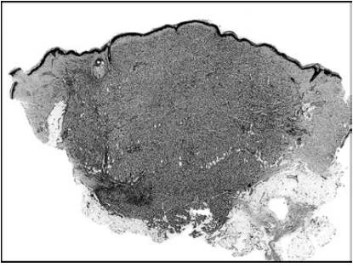
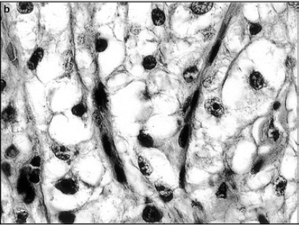
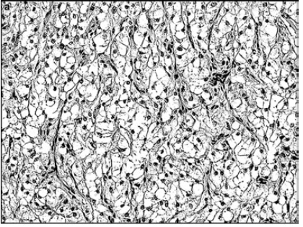
DDX: Cutaneous PEComa
Mentzel et al., Histopathology 2005, 46, 498–504

Slide 48
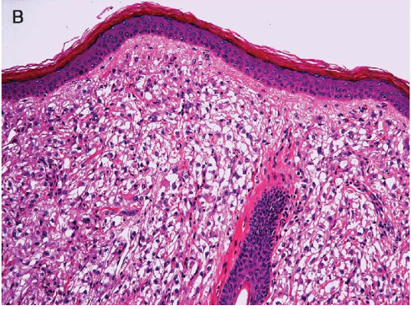
Liegel et al, Am J Surg Pathol 2008;32:608–614

Slide 49
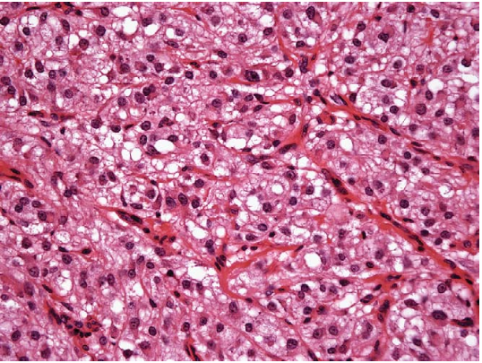
Liegel et al, Am J Surg Pathol 2008;32:608–614

Slide 50
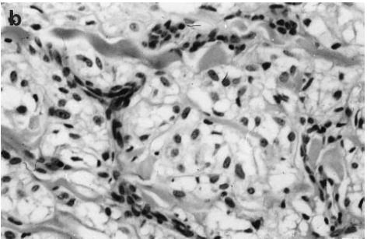
DDX: Clear cell dermatofibroma
Zelger et al. Histopathology 1997, 30, 64-69

Slide 51
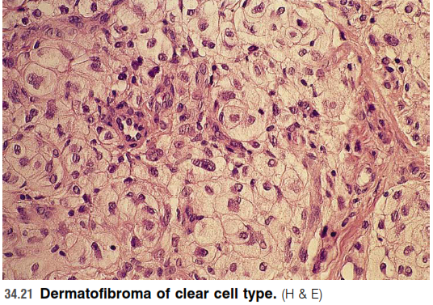

Slide 52
DDX: Clear cell AFX

Slide 53
DDX: Baloon cell melanoma

Slide 54
DDX: Cutaneous atypical lipoma

Slide 58
MDM2
P16

Slide 59
Thank you !

